Slide 2
Schedule
9:00-9:15 Introduction to Chemometec Brief introduction to our core business, competences, history and portfolio.
9:15-10:00 xC-100 family of products Introduction to mammal, yeast, spermatozoide and somatic cell counters.
10:00-10:15 Break
10:15-11:00 NC-200 and the NucleoView interface Virtual demonstration of the NucleoView GUI
11:00-12:00 NC-250, NC-3000 and applications portfolio Introduction NC-250 and background knowledge for fixed applications
12:00-13:00 Lunch
13:00-14:30 (Optional) Exercise with demonstrational data or sample analysis

Slide 3
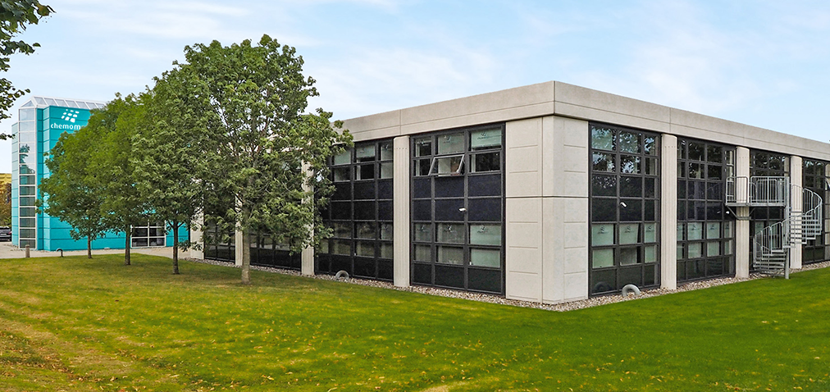
Company profile
www.chemometec.com

Slide 4
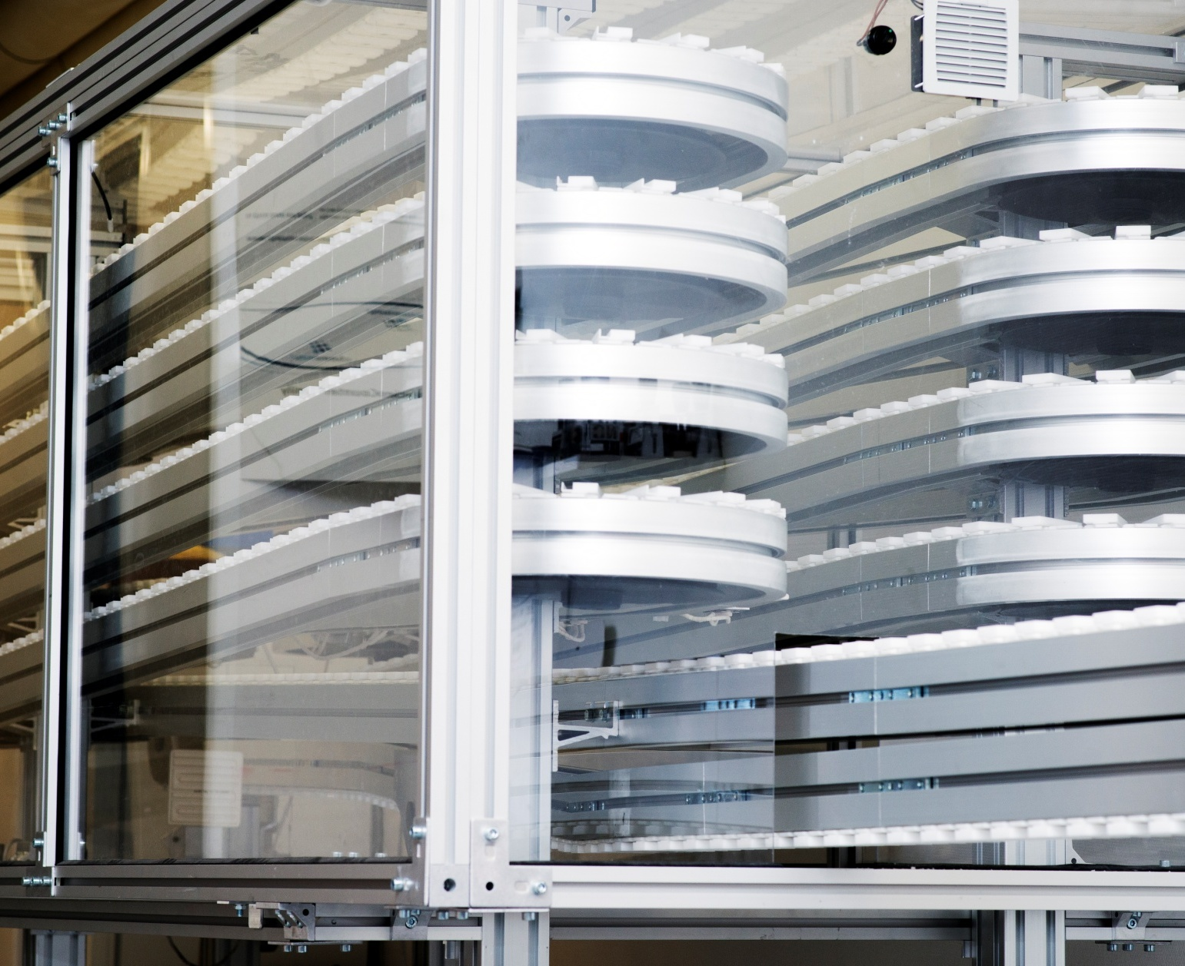
Outline
About us
Technology
NucleoCounter® Family
Consumables
Competencies
Business presence
Customers
Distribution

Slide 5
Allerød, Denmark
About us
Founded in Denmark in 1997, ChemoMetec is committed to developing and improving analytical measurement techniques within the fields of cell counting and cell analysis.
Chemometec has a strong pipeline for development of new products, which aims at continuously introducing the next generation of solutions in the field.
We are listed on the Copenhagen stock exchange and have products being used in over 100 countries around the world.

Slide 6
Vision
To work consistently to improve analytical measurement techniques within the fields of particle counting and liquid chemical composition determination.
Mission
To become the supplier and partner of choice not only for end-users but also for distributors and agents.

Slide 7
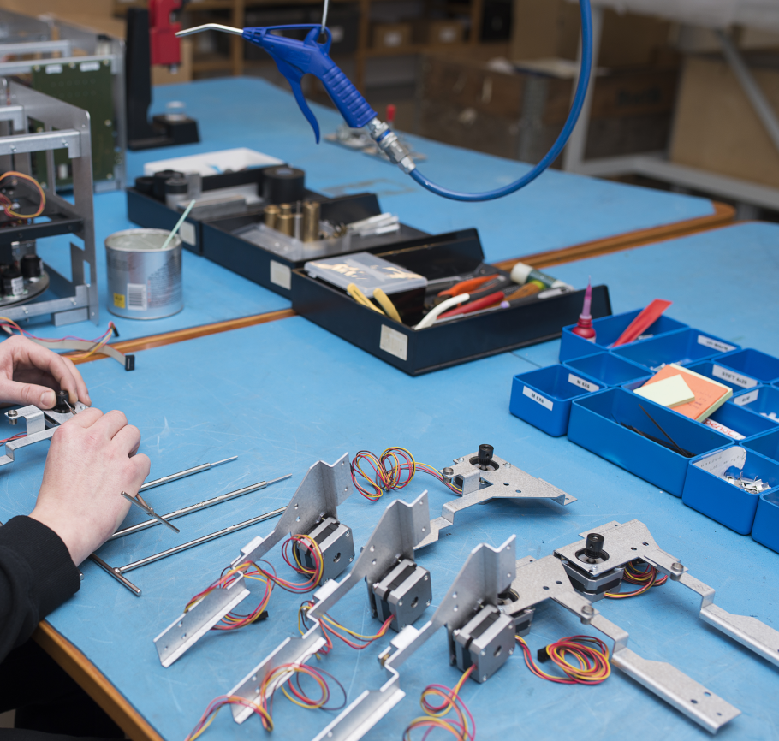
Our technologies
LED-based flourescence microscopy for:
Image analysis: xC-100/200 family
Image cytometry: NC-3000

Slide 8
Introducing the NucleoCounter® Family
NucleoCounter® NC-3000™ Advanced cell analysis
NucleoCounter® NC-250™ Multi-chamber analysis
NucleoCounter® NC-200™ One-step viability and cell count
NucleoCounter® NC-100™ Mammalian cells in cell cultures
NucleoCounter® SP-100™ Sperm cells in semen
NucleoCounter® YC-100™ Yeasts cells in beverage and biotech/pharma
NucleoCounter® SCC-100™ Somatic cells in milk
NucleoCounter® SCC-400™ Flow-based somatic cells in milk

Slide 9
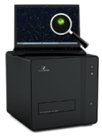
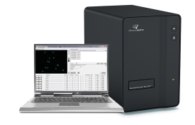
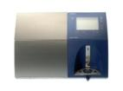
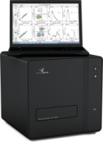
Introducing the NucleoCounter® Family
License agreement
DeLaVal - Tetra Pak Milk I
NucleoCounter
NC-100
NucleoCounter
YC/SCC/SP-100
NucleoCounter
NC-3000 FlexiCyte
NucleoCounter
NC-250
1997
1998
2000
2002
2004
2007
2009
2010
2011
2013
License agreement
DeLaVal - Tetra Pak Milk II
License agreement
FOSS Milk III
NucleoCounter
NC-3000
NucleoCounter
NC-200

Slide 10
Biomarkers
NC-3000™
Slides A2/A8
Apoptosis
NC-3000™
GFP
Instrument’s
Application Portfolio
Cell Cycle
NC-250™
Vitality
Cassettes
1-step Viability and Cell Count
NC-200™
Cell Count
(2-step Viability)
NC-100™, YC-100 ™,
SP-100 ™, SCC-100 ™

Slide 11
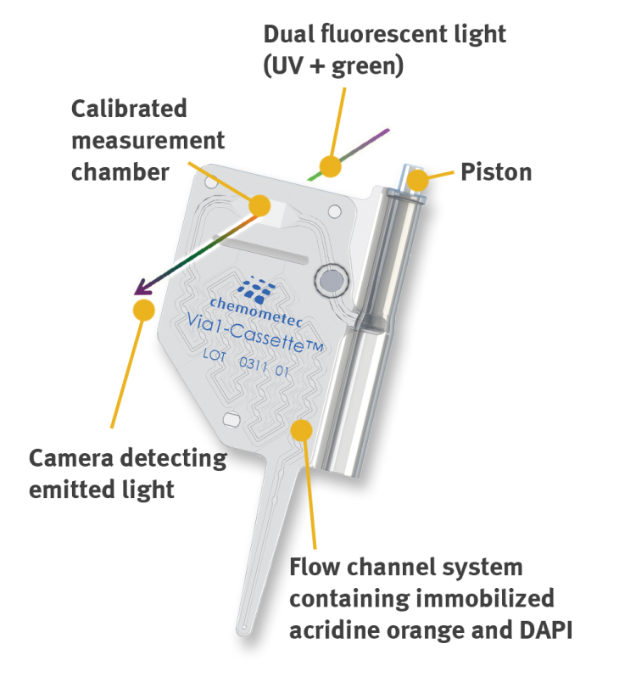
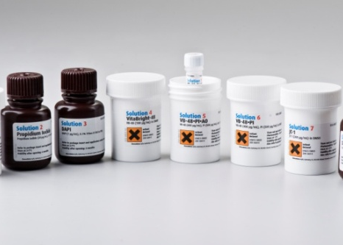
Consumables
Via1-cassette™
NC-Slide™ A8 and NC-Slide™ A2
Reagents and Solutions

Slide 12
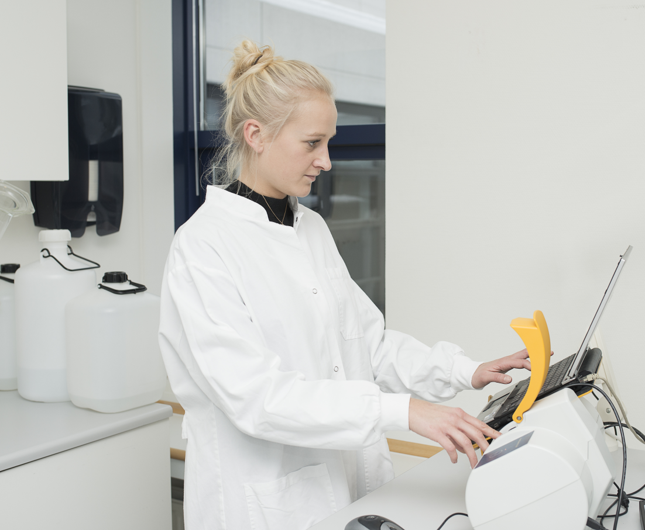
Competencies
Biology & Chemistry Cell identification, spectrophotometry
Mechanics & Electronics Injection molding, optics
Software Embedded SW, PC SW
Intellectual Property Rights 90 issued/pending patents worldwide, 15 patent families
Sales & Marketing

Slide 13
Core business presence
Stem Cell Research Advanced analysis of cell parameters including cell cycle profiling, apoptosis and bio-marker detection for use in research, production and quality control.
BioProcessing Quality products that meet QC/QA demands in a GMP-regulated environment
Cancer Cell Research In-depth analysis and screening of apoptosis and many other essential parameters evaluated in cancer research, with high precision results for viability and cell count.
Toxicology High precision viability and cell count for the study of cytotoxicity, enhanced by the ability to study cell health in great detail.
Cell Therapy MSC, iPSC and CAR-T, among others, are currently being evaluated in clinical trials for a broad spectrum of indications.
Cell Biology Quality products that meet QC/QA demands in a GMP-regulated environment
Notes:
Broad business segmentation: Laboratories that works with cells!
Generally life science is divided into three segments:
Pharma / Biotech
Governmental / Academia
Health care (needs In Vitro Diagnostics (IVD) certificates)

Slide 14
Other applications
Sperm cell Counting Accurate knowledge of sperm cell concentration and cell viability in semen is of vital importance to successful insemination.
Yeast cell counting Concentration and viability of yeast cells are important factors in a variety of fermentation and production processes.
Somatic cell counting Assessing milk quality by accurate somatic cell measurements.

Slide 15
Customers
www.chemometec.com
www.chemometec.com

Slide 16
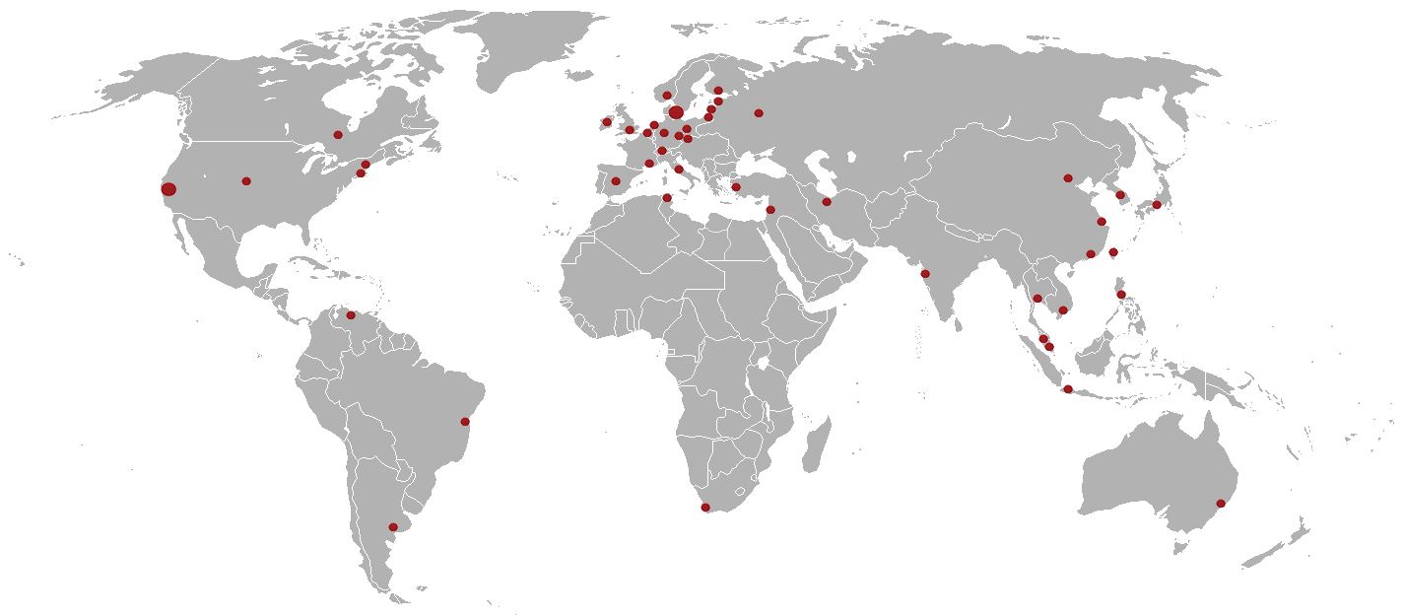
Our distribution
www.chemometec.com
www.chemometec.com

