Slide 1
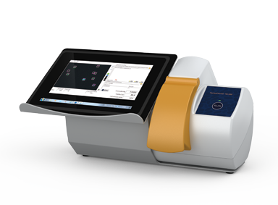
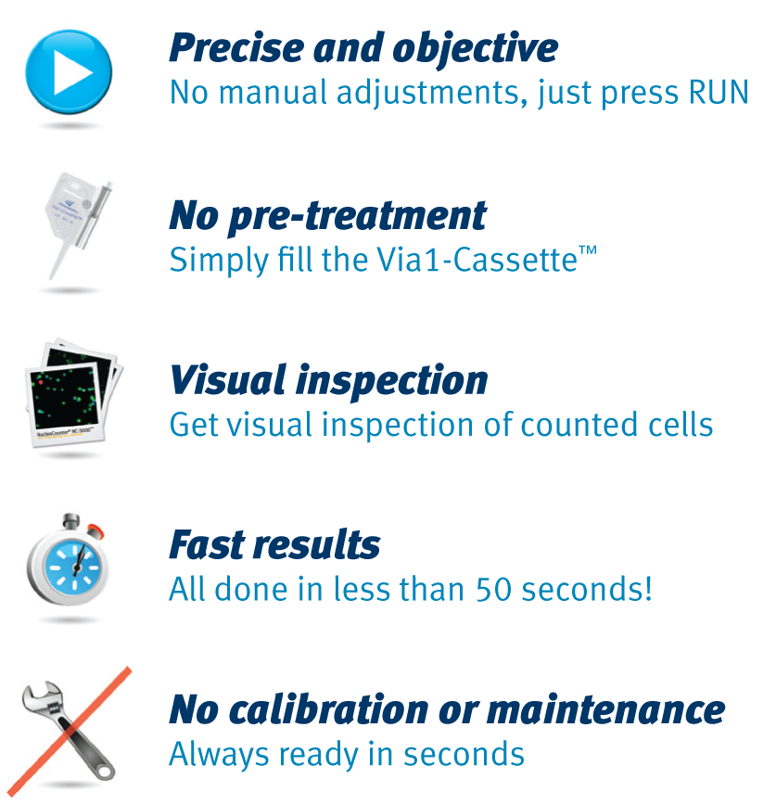
NucleoCounter® NC-200™
One step viability and cell count without pre-treatment
Easiest Cell Count Ever!

Slide 2
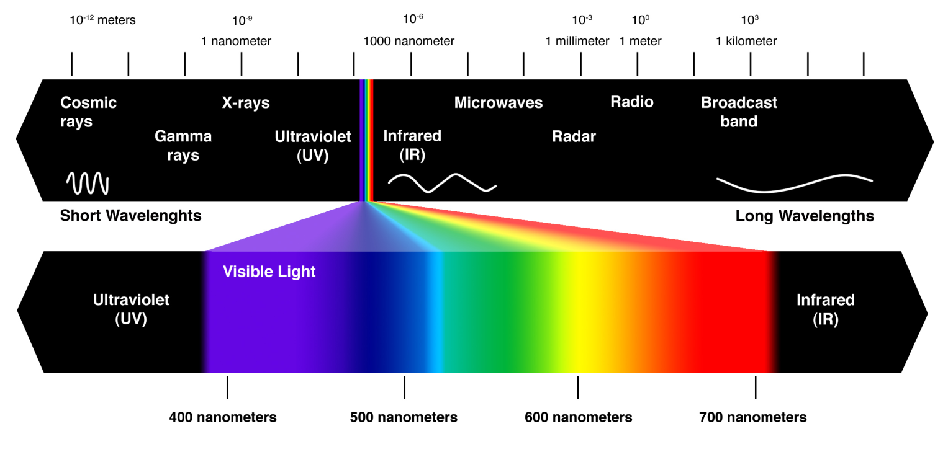
NucleoCounter® Technology
Fluorescence is the emission of light by a substance that has absorbed light or other electromagnetic radiation. In most cases, the emitted light has a longer wavelength, and therefore lower energy, than the absorbed radiation (Stoke’s Law).

Slide 3
NucleoCounter® Technology
Highly reliable LEDs
Minimal intensity drift after millions of measurements.

Slide 4
NucleoCounter® Technology
Integrated Fluorescence Microscope
Lenses: magnification <1X.
Excitation filter: sorts out green light.
Emission filter: sorts out long wave length including red light.
CCD: Charged Coupled Device
LED: Light Emitting Diodes

Slide 5
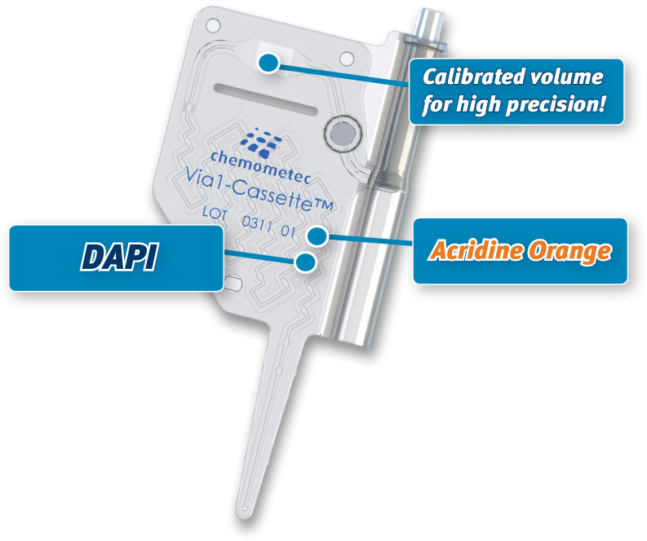
Via1-Cassette™: One-step viability count
Easiest viability and cell count in the world!
Ready to load
Laser-calibrated volume
Safe handling & disposal
No warm-up
Dead cells
Total cells

Slide 6
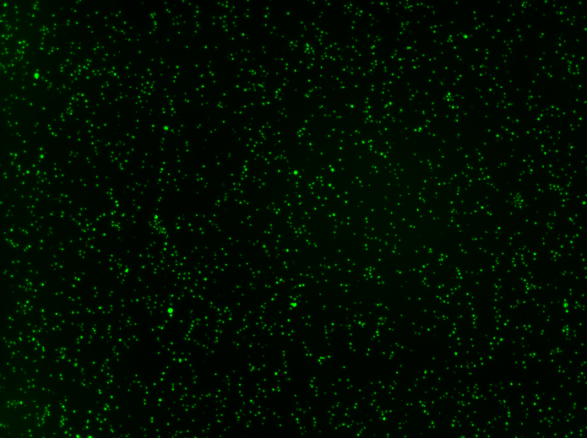
3.4 x 106 cells pr. mL (total count)
Total count based on Acridine Orange (AO)
Notes:
This an image from NC-3000 of cells stained in the Via1 cassette. Hence, these cells are stained with acridine orange and DAPI. This image is taken using our blue light source and green emission filter and only the Acridine fluorephore is visiualised. Acridine orange positive cells represent the total cell population.

Slide 7

9.1 x 105 non-viable cells pr. mL
Dead count based on DAPI
Notes:
This an image of the same cells now using the UV light source and the blue emission filter of NC-3000. Here only the DAPI positive cells are visiualised. These represent the dead cells.

Slide 8
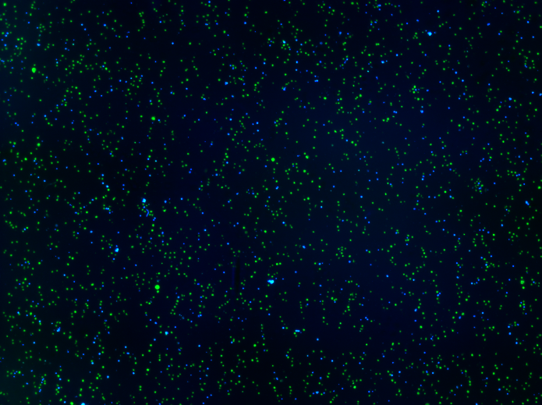
Viability = 73.5 %
Viability based on AO-DAPI overlay
Notes:
This image is and superimposition of the green and blue images. From the two images we can calculate the viability.

Slide 9



We eliminated factors causing common errors and variation
NC-200™ and Via1-Cassette™
No reagents
No pipetting
No manual adjustments
PRECISION and OBJECTIVENESS of results

Slide 10
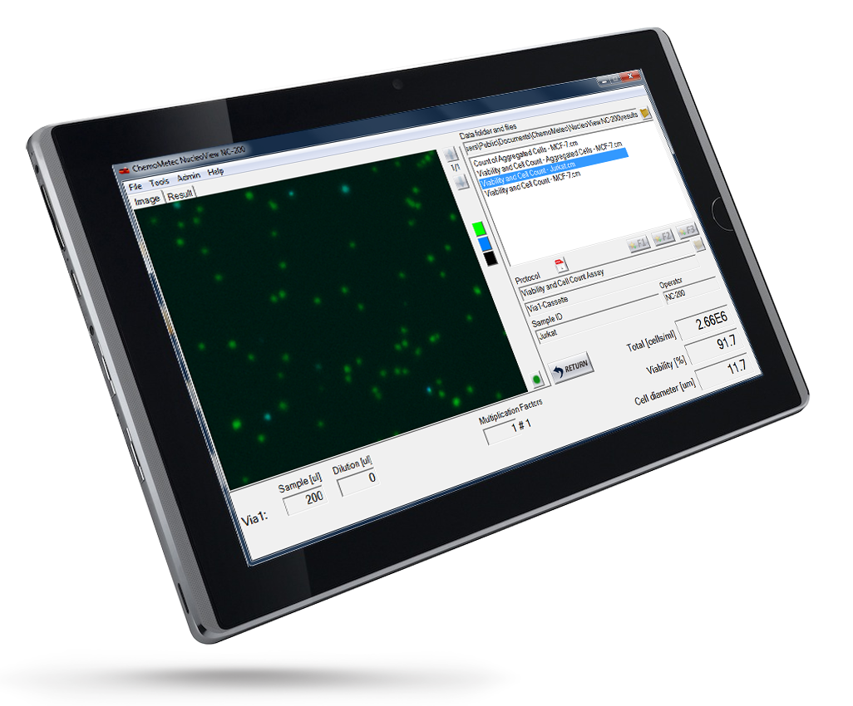
NucleoView NC-200™: Superior data presentation
View, adjust, compare and export results
Browse data from previous samples
Easy selection of protocols
Visual inspection of counted cells
Easy access to application notes
Easy export of data to e.g. Excel
Plot Manager to view gates
Wizard for easy adaptation

Slide 11
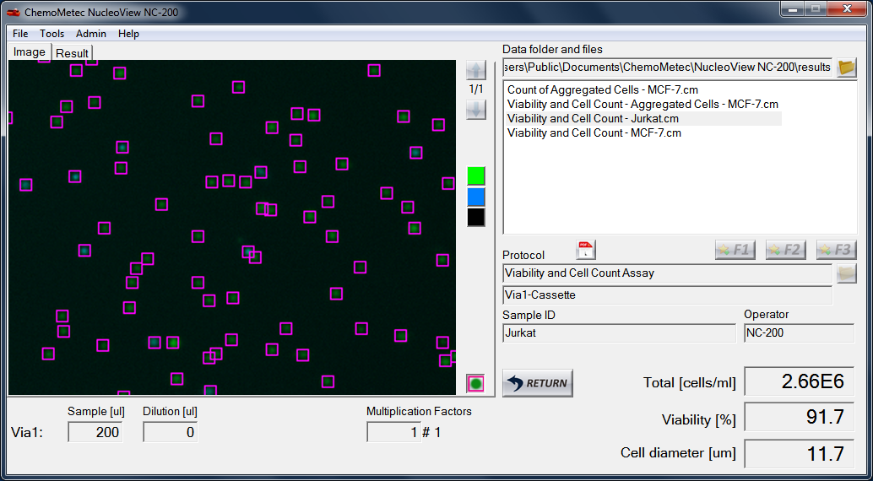
NucleoView NC-200™
Flexibility to adjust parameters to your needs
Results database
Visual inspection
Quick results
Dilution calculation

Slide 12
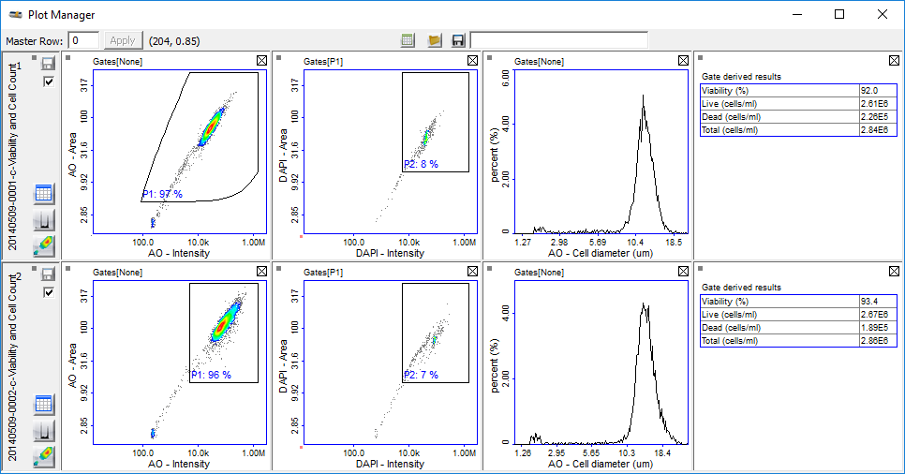
Plot Manager
View, adjust, compare and export results
In-depth
results
Adjust
gates
Compare
results
Export
to Excel

Slide 13
Flexibility: Adapt Protocol Using the Wizard
Easy protocol adaptation
Guided steps
Save optimized gatings for odd cell lines
Focus on aspects of results that are important to you
Save adjusted
gates

Slide 14
NucleoCounter® NC-200™
The ideal solution for quick and reliable
cell counting!

