Slide 1
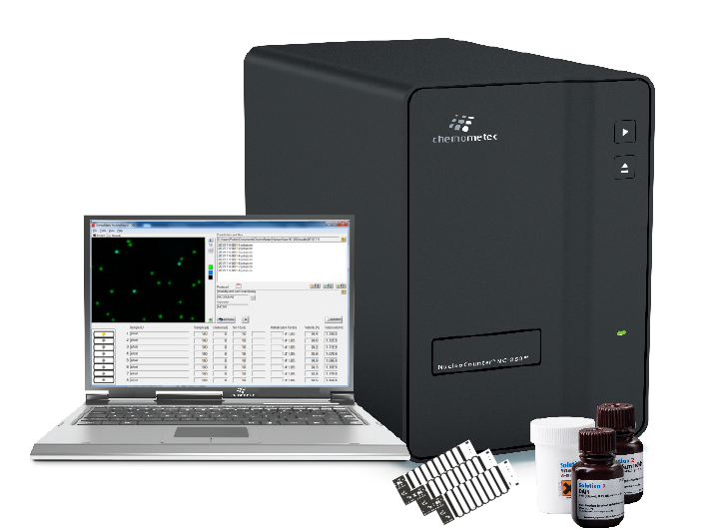
NucleoCounter®NC-250™
More than a counter!
Fast and reliable:
Cell Count
Viability
Cell Health
Cell cycle

Slide 2
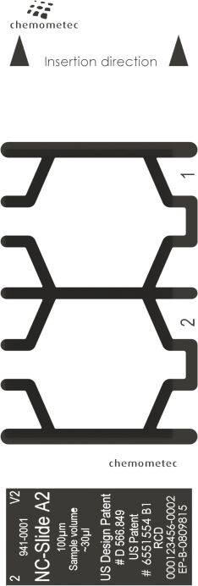
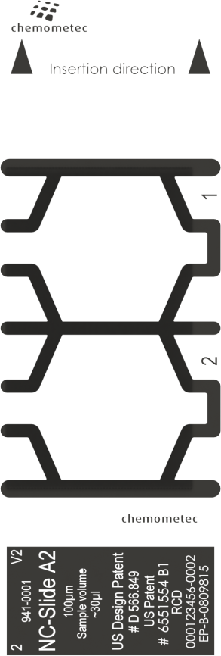
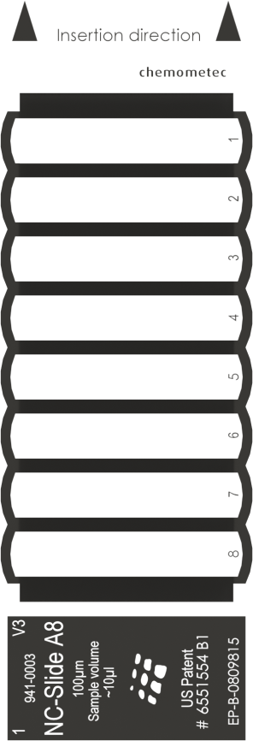
Introducing NC-Slide™ A2 and A8
High speed measurement and statistical robustness
NC-Slide A2™
Better statistics
30 µl sample
Up to 16 µl analyzed volume
NC-Slide A8™
Fast Measurements
8 viability counts < 3 min
Low sample volume (10 µl)
Lower cost per sample!
Fast and Precise!

Slide 3

NucleoCounter®NC-250™
More than a counter!
Excellent as problem solver where the others have given up!
Expanded fixed assays:
One-Step Viability and Cell Count
  Load and press Run
Two-Step Viability and Cell Count
  Micro-Carriers – extremely aggregated cells
Two-step Cell Cycle
  Innovative 5 min. Cell Cycle Assay
Cell Vitality
  Cell health determination via the fastest apoptosis assay
What if you knew your cells’ health before they were dying?

Slide 4
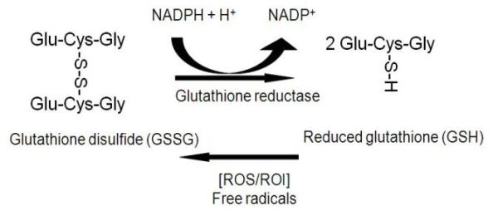
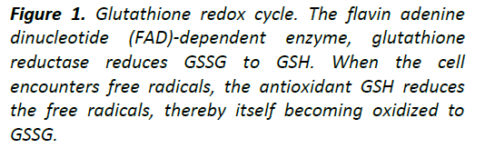
Cell Vitality using Vitabright-48™ (VB-48)
Patented Chemometec technology
Very fast detection of vitality (< 45 seconds analysis time)
Measures reduced thiols and correlates with
early and mid-stage apoptotic markers
Reduced glutathione (GSH):
  Predominant thiol in cells
  Protects cells against oxidative
  damage (detoxifier)
  Changes in GSH is an early apoptotic
  marker (in some cells)
Notes:
Glutathione is the predominant intracellular free thiol; thus, its oxidation status largely determines the thiol- disulfide status of the cell by thiol-disulfide interchange reactions. (Some ref. only says “smal molecule thiol”)
Glutathione exists in reduced (GSH) and oxidized (GSSG) states. In the reduced state, the thiol group of cysteine is able to donate a reducing equivalent (H+ + e-) to other unstable molecules, such as reactive oxygen species. In donating an electron, glutathione itself becomes reactive, but readily reacts with another reactive glutathione to form glutathione disulfide (GSSG). Such a reaction is possible due to the relatively high concentration of glutathione in cells (up to 5 mM in the liver). GSH can be regenerated from GSSG by the enzyme glutathione reductase.
In healthy cells and tissue, more than 90% of the total glutathione pool is in the reduced form (GSH) and less than 10% exists in the disulfide form (GSSG). An increased GSSG-to-GSH ratio is considered indicative of oxidative stress.
Oxidative stress is a facet of many diseases, such as chronic lung diseases (for example, asthma, chronic obstructive pulmonary disease, lung cancer, idiopathic fibrosis and cystic fibrosis), cardiovascular diseases/disorders (such as atherosclerosis and myocardial infarction), neurodegenerative disorders, rheumatoid arthritis, amyotrophic lateral sclerosis and diabetes, and has recently been implicated in AIDS. Oxidative stress has a profound effect on the cellular thiol balance and can lead to a decreased GSH/GSSG ratio in many body organs. Reactive oxygen species (ROS)—superoxide anion (O2 .–), hydroxyl radical (.OH), hydrogen peroxide (H2O2) and hydroperoxides (R–OOH)—xenobiotics and other organic radicals are neutralized by GSH through a concerted cascade of detoxification mechanisms involving glutathione peroxidases (GPx), glutathione-S-transferases (GST) and glutathione reductase (GR).
Apart from this, GSH also takes part in signal transduction, gene expression, apoptosis and host of other cellular reactions. Therefore, GSH/GSSG status is frequently measured in physiological and pathophysiological conditions.

Slide 5
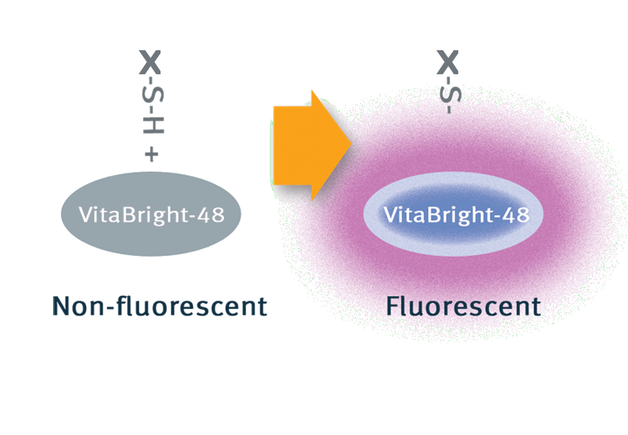
Vitabright-48™
Fluorescence intensity of VitaBright-48™ is used as an indicator of the oxidative state (stress level) of cells.
Oxidative stress
(ROS/ROI)
e⁻
Notes:
VitaBright-48 reacts with reduced glutathione (GSH) (but NOT GSSG) forming a strongly fluorescent product – the reaction is stoichiometric and we can thus directly measure the GSH level in each cell by quantifying the fluorescence of the cell

Slide 6
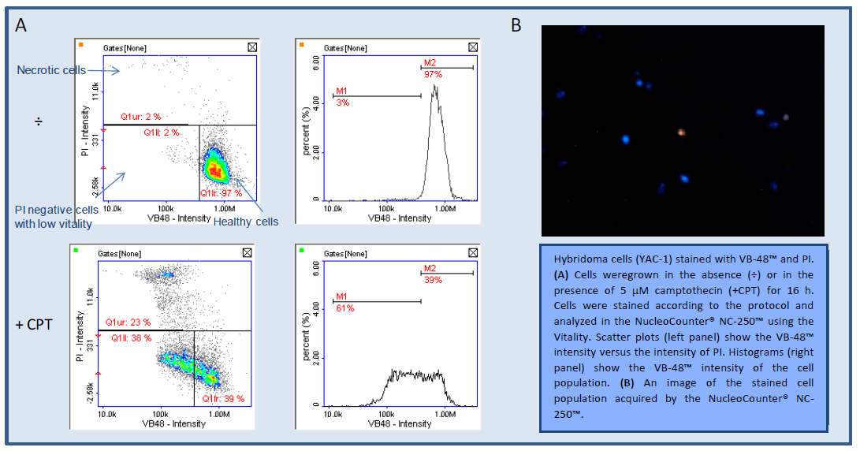
Cell Vitality Assay
Extremely easy assay for evaluation of cellular health, oxidative stress and indirect detection of apoptosis
Notes:
Scatter plots and histograms showing thiol level distribution (VB-48 intensity) in the cell population are automatically displayed after analysis.
By comparing the VB-48 intensity of treated cells and control cells the fraction of cells with low vitality (e.g. apoptotic or stressed cells) can be determined.

Slide 7
Two-Step Cell Cycle Assay
The fastest
high precision
Cell Cycle
Analysis
Extremely fast and easy cell cycle assay
No ethanol fixing
Directly from T-Flasks or wells (no detachment step)
No RNase treatment required
Standardized Results
Patent pending

Slide 8
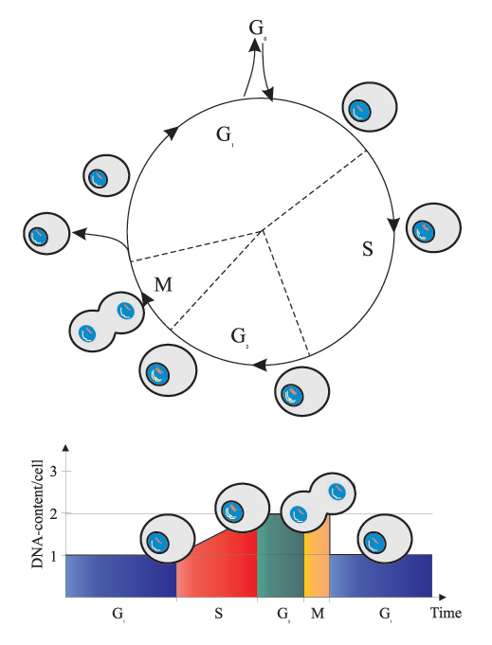
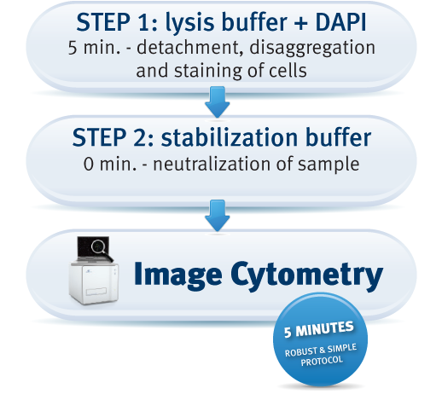
Two-step Cell Cycle Assay
Fast and easy measurement of cell cycle phases at the single cell level

Slide 9
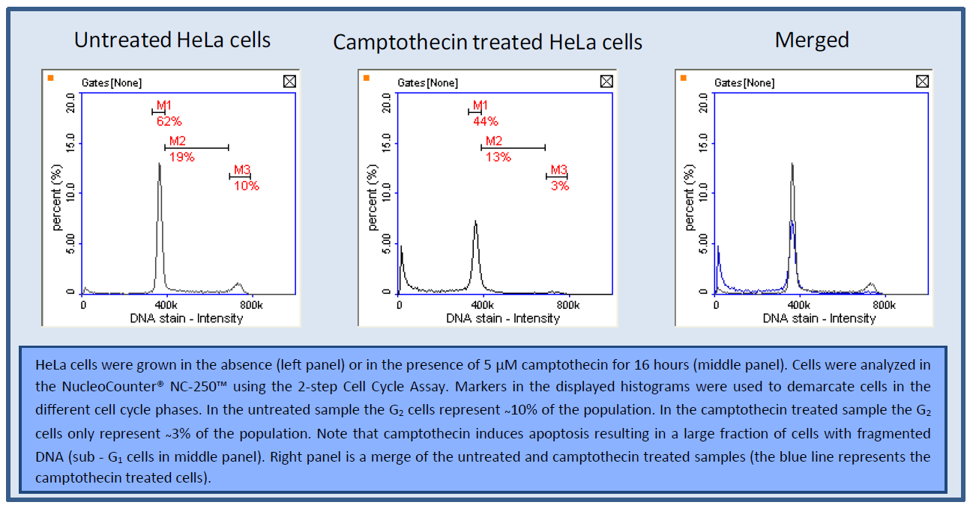
Two-step Cell Cycle Assay
Fast and easy measurement of cell cycle phases at the single cell level

Slide 10
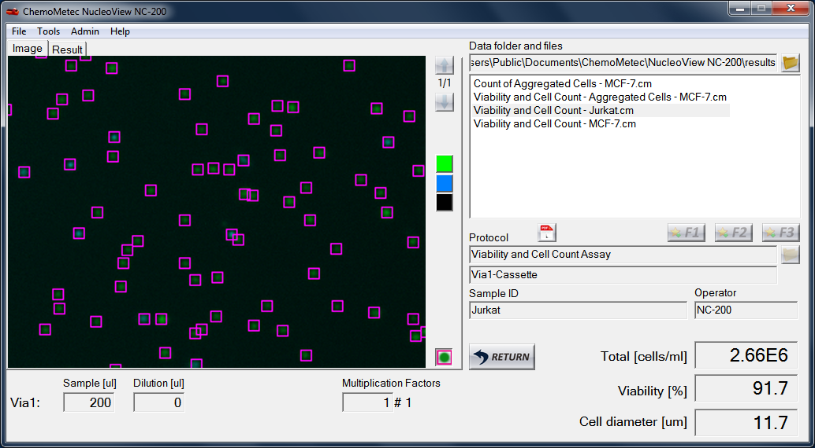
NucleoView NC-250™
Flexibility to adjust parameters to your needs
Results database
Visual inspection
Quick results
Dilution calculation

Slide 11
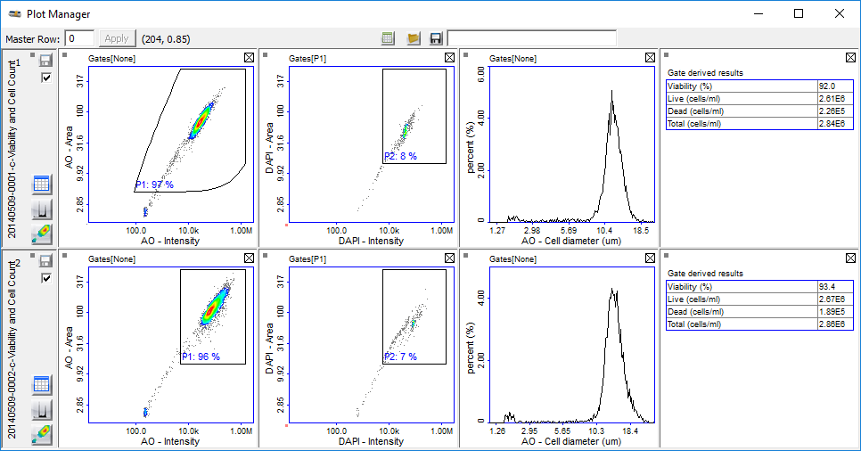
Plot Manager
View, adjust, compare and export results
In-depth
results
Adjust
gates
Compare
results
Export
to Excel

Slide 12
Flexibility: Adapt Protocol Using the Wizard
Easy protocol adaptation
Guided steps
Save optimized gatings for odd cell lines
Focus on aspects of results that are important to you
Save adjusted
gates

Slide 13
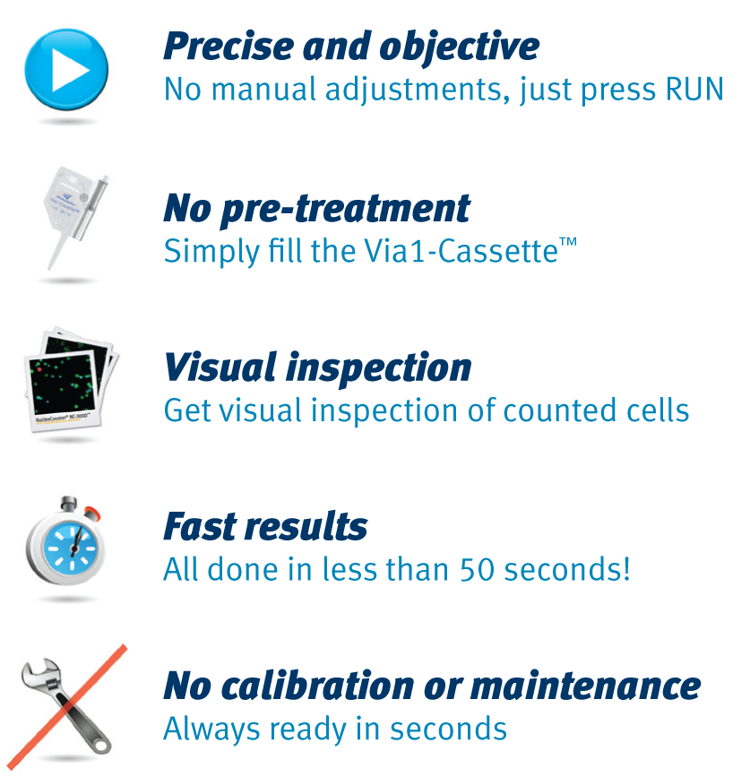
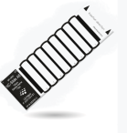


NucleoCounter®NC-250™
More than a counter!
Precise and objective
No manual adjustments, just press RUN
High speed cell count
8 samples done in less than 3 minutes!
Counting & Analytical Assays
Cell health determination
Low running costs
Reduce your running costs significantly
Calibration and maintenance free
Instantly ready

