Slide 1
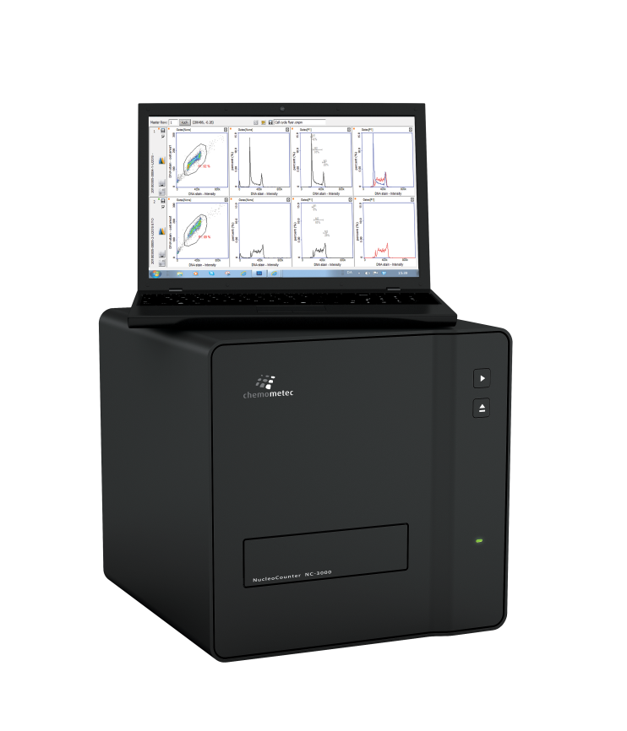
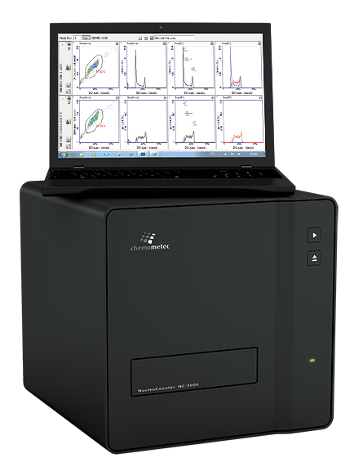
NucleoCounter® NC-3000™
A new approach to advanced cell analytics
without the flow cytometry limitations
ROBUSTNESS
in Full Spectrum

Slide 2
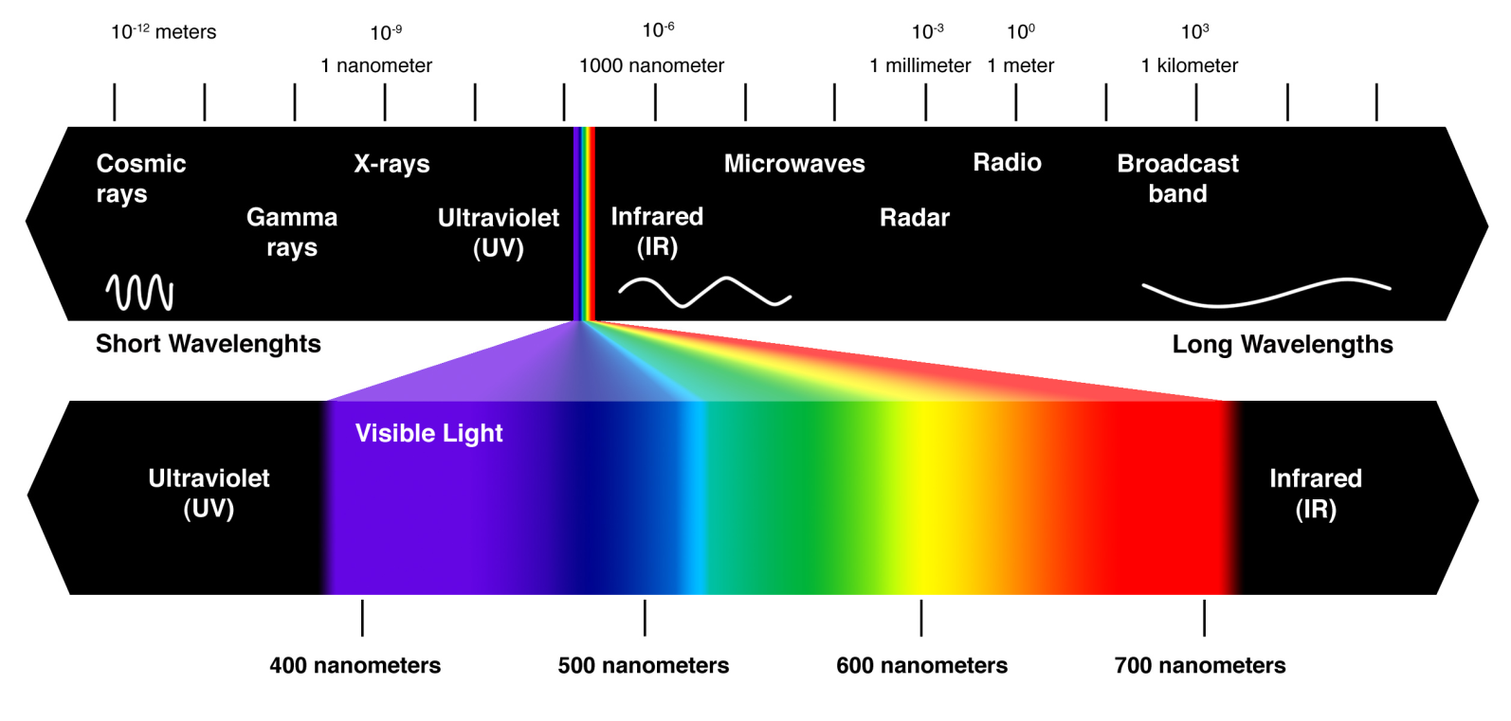
NC-3000™ Technology – Built to perform!
Fluorescence is the emission of light by a substance that has absorbed light or other electromagnetic radiation. It is a form of luminescence. In most cases, the emitted light has a longer wavelength, and therefore lower energy, than the absorbed radiation (Stoke’s Law).

Slide 3
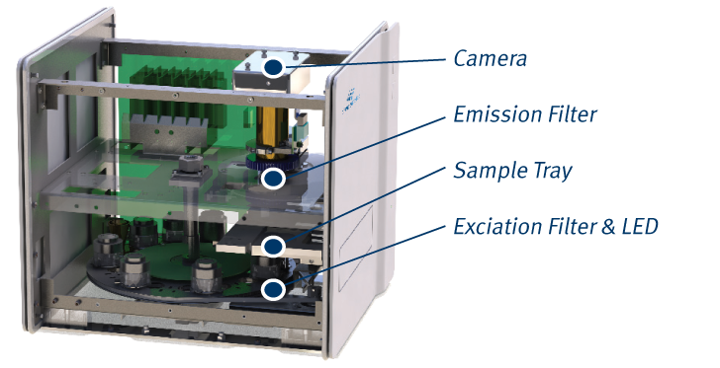
NC-3000™ Technology - Built to perform!
7 excitation colors
9 emission filters (from UV to far red)

Slide 4
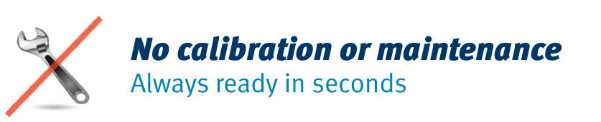
NC-3000™ Technology - Built to perform!
Highly reliable LEDs
Minimal intensity drift after millions of measurements.

Slide 5
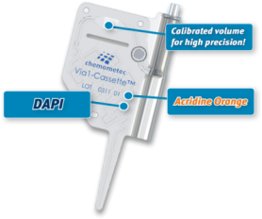
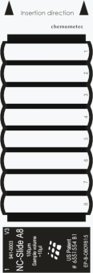
Flexibility in sampling media types
Cassettes:
  Fast, practical and safe internal chemistry
  Laser-calibrated volumetric precision
  Analyzed volume: 3,2 μl (4x 0,8 µl images)
  Examples: PI-Cassette™, Via1-Cassette™
NC-Slides:
  Multiple samples at a time
  Statistical robustness (analyzed volume 0.8-16 μl)
  Examples: 2 chamber NC-Slide A2™, 8 chamber NC-Slide A8™

Slide 6
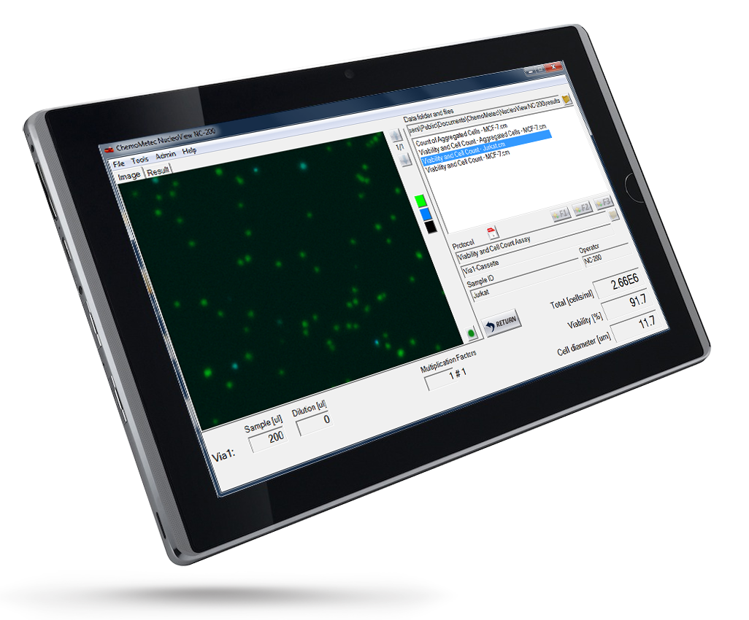
NucleoView NC-200™: Superior data presentation
View, adjust, compare and export results
Browse data from previous samples
Easy selection of protocols
Visual inspection of counted cells
Easy access to application notes
Export data in FCS and ACS
Plot Manager to view gates
Wizard for easy adaptation

Slide 7
How do I use the NC-3000™?
Prepare cell sample
What happens inside the NC-3000™
Turn on NC-3000™ and PC
NC-3000™ selects appropiate exposure time, LEDs and filters
Place cassette/NC-Slide in
sample tray
NC-3000™ captures image(s)
Select type of application and press run
NC-3000™ calculates data
Computed data are displayed on PC

Slide 8

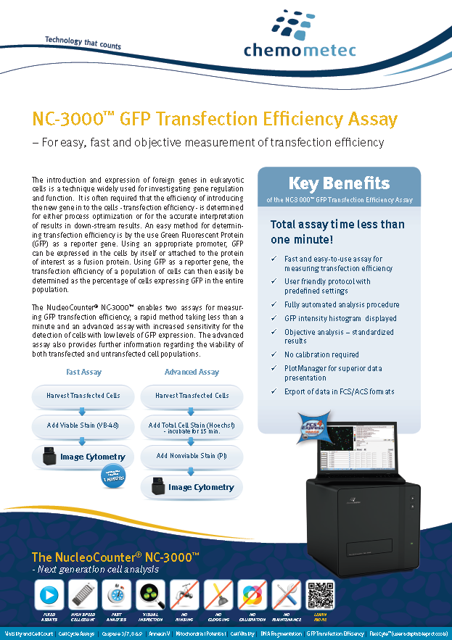
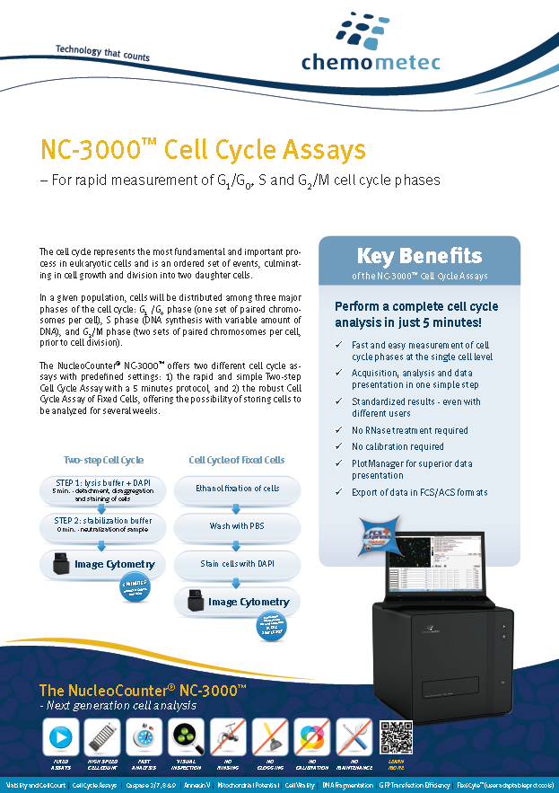
Attested Fixed Protocols
Viability and Cell Count
Cell Vitality
Mitochondrial Potential
Annexin V
Caspase 3/7, 8 & 9
DNA Fragmentation
Two-step Cell Cycle
Cell Cycle of Fixed Cells
GFP Transfection Efficiency

Slide 9
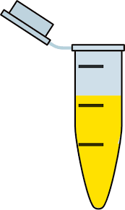
Viability and Cell Count Assay
Qualification: choose the best fit analysis for the sample
Purified Leucocytes
Run “Purified Leucocytes Assay” in Via1
Full Blood Sample
Run “Blood Assay” in A2/A8 + Sol. 17
Via 1
Single Cells
Aggregated Cells
A2/A8

Slide 10
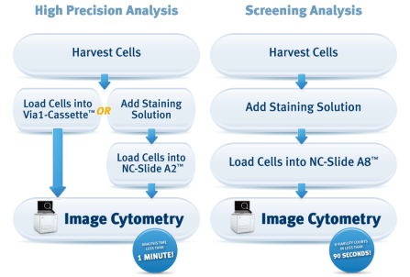
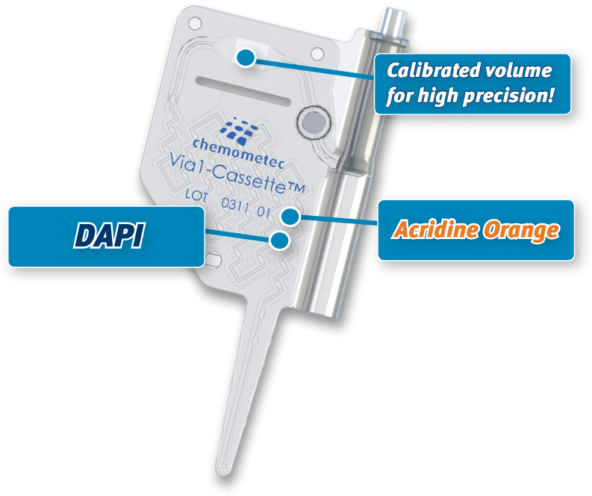
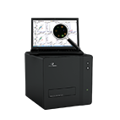
Viability and Cell Count Assay
Focus on the most important aspect of the process
High Precision Analysis
Screening Analysis
Quick Precision Analysis
Notes:
Using fluorescence microscopy and image analysis, the NucleoCounter® NC-3000™ automates the detection of cells. The NC-3000™ Viability and Cell Count Assays use the cell stain Acridine Orange for cell detection, and the nucleic acid stain DAPI for detecting non-viable cells. DAPI cannot penetrate the cell membrane, hence it only stains cells with a permeable cell membrane; the non-viable cells.
The different Viability and Cell Count Assays are optimized for viability and cell counting of mammalian and insect cells, E.g. Purified leucocytes, cells in peripheral blood samples.
For high precision use the Via1-Cassette™ or the NC-Slide A2™ and for screening use the NC-Slide A8™.

Slide 11
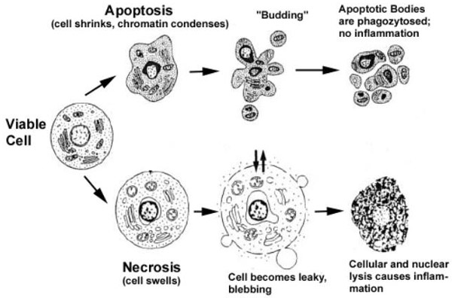

Apoptosis Assays
Apoptosis and Necrosis: Two ways of dying
Death by apoptosis
“Clean death” - no release of cell content
Cells induced to commit suicide by physiological stimuli, e.g. lack of growth factors, changes in hormonal environment, disturbance of cell cycle
Death by necrosis
Cell leakage
Evoked by non-physiological disturbance, e.g. mechanical damage, hypoxia, exposure to metabolic toxins
Notes:
This slide just summarize the two pathways of death.
Apoptosis causing cell shrinkage
And necrosis causing cell swelling and release of cellular content.
How do you distinguish between apoptotic and necrotic cells? That can a complicated task
The apoptotic pathway is in-itself quite complex and many of the physiological and biochemical feature of apoptosis overlaps with that of necrosis.
Hence, to make a definitive conclusion that a cell is apoptotic it’s important to perform several independent assays.

Slide 12
Hallmarks of apoptosis
Time | Cell function changes | NC-3000 | Invitrogen
Start End | Mitochondrial membrane potential | Mitochondrial Potential Assay | MitoTracker Red MitoProbe kits
 | Mitochondrial transition pore |  | MitoProbe Transition pore
 | Phosphatidyl translocation | Annexin V | Numerous Annexin V kits
 | Caspase activity | Mulitiple FLICA assay | Numerous caspase kits
 | Metabolic activity | Vitality Assay | Vybrant Metabolic kits
 | DNA condensation | Combined Hoechst/PI stain¹ | Hoechst stain
 | Plasma membrane integrity | Viability and Cell Count, DAPI², PI³ | PI Sytox Green dye
 | DNA fragmentation | DNA Fragmentation assay | TUNEL assay
¹ Proof of concept obtained, but application has not been released
² Included in Mitochondrial Potential assay
³ Included in Vitality assay

Slide 13
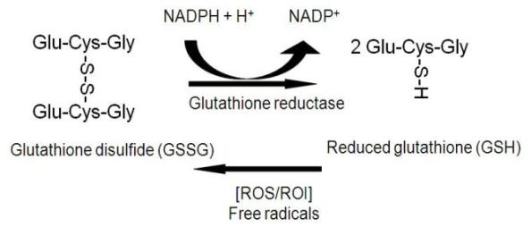
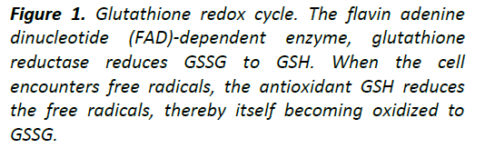
Cell Vitality using Vitabright-48™ (VB-48)
Patented Chemometec technology
Very fast detection of vitality (< 45 seconds analysis time)
Measures reduced thiols and correlates with
early and mid-stage apoptotic markers
Reduced glutathione (GSH):
  Predominant thiol in cells
  Protects cells against oxidative
  damage (detoxifier)
  Changes in GSH is an early apoptotic
  marker (in some cells)
Notes:
Glutathione is the predominant intracellular free thiol; thus, its oxidation status largely determines the thiol- disulfide status of the cell by thiol-disulfide interchange reactions. (Some ref. only says “smal molecule thiol”)
Glutathione exists in reduced (GSH) and oxidized (GSSG) states. In the reduced state, the thiol group of cysteine is able to donate a reducing equivalent (H+ + e-) to other unstable molecules, such as reactive oxygen species. In donating an electron, glutathione itself becomes reactive, but readily reacts with another reactive glutathione to form glutathione disulfide (GSSG). Such a reaction is possible due to the relatively high concentration of glutathione in cells (up to 5 mM in the liver). GSH can be regenerated from GSSG by the enzyme glutathione reductase.
In healthy cells and tissue, more than 90% of the total glutathione pool is in the reduced form (GSH) and less than 10% exists in the disulfide form (GSSG). An increased GSSG-to-GSH ratio is considered indicative of oxidative stress.
Oxidative stress is a facet of many diseases, such as chronic lung diseases (for example, asthma, chronic obstructive pulmonary disease, lung cancer, idiopathic fibrosis and cystic fibrosis), cardiovascular diseases/disorders (such as atherosclerosis and myocardial infarction), neurodegenerative disorders, rheumatoid arthritis, amyotrophic lateral sclerosis and diabetes, and has recently been implicated in AIDS. Oxidative stress has a profound effect on the cellular thiol balance and can lead to a decreased GSH/GSSG ratio in many body organs. Reactive oxygen species (ROS)—superoxide anion (O2 .–), hydroxyl radical (.OH), hydrogen peroxide (H2O2) and hydroperoxides (R–OOH)—xenobiotics and other organic radicals are neutralized by GSH through a concerted cascade of detoxification mechanisms involving glutathione peroxidases (GPx), glutathione-S-transferases (GST) and glutathione reductase (GR).
Apart from this, GSH also takes part in signal transduction, gene expression, apoptosis and host of other cellular reactions. Therefore, GSH/GSSG status is frequently measured in physiological and pathophysiological conditions.

Slide 14
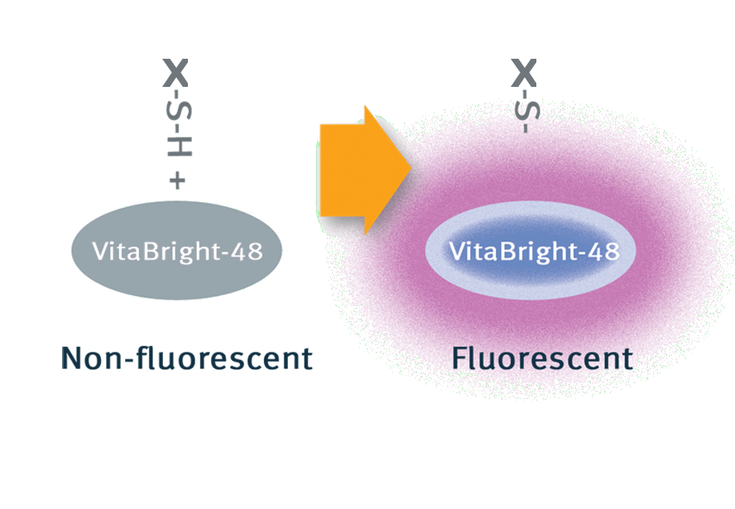
Vitabright-48™
Fluorescence intensity of VitaBright-48™ is used as an indicator of the oxidative state (stress level) of cells.
Oxidative stress
(ROS/ROI)
e⁻
Notes:
VitaBright-48 reacts with reduced glutathione (GSH) (but NOT GSSG) forming a strongly fluorescent product – the reaction is stoichiometric and we can thus directly measure the GSH level in each cell by quantifying the fluorescence of the cell

Slide 15
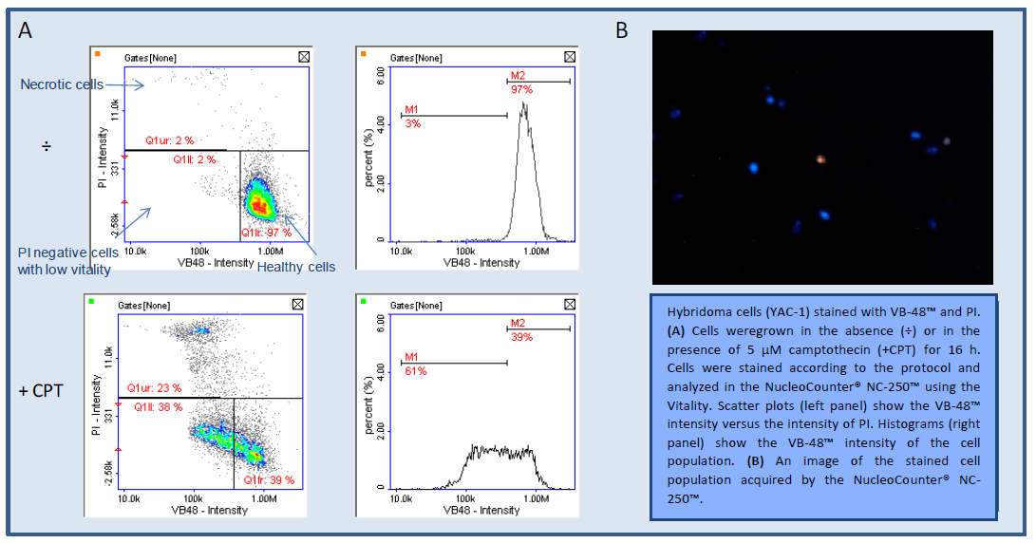
NC-3000™ Cell Vitality Assay
CPT = Camptothecin (Topoisomerase inhibitor)
Notes:
Scatter plots and histograms showing thiol level distribution (VB-48 intensity) in the cell population are automatically displayed after analysis.
By comparing the VB-48 intensity of treated cells and control cells the fraction of cells with low vitality (e.g. apoptotic or stressed cells) can be determined.

Slide 16
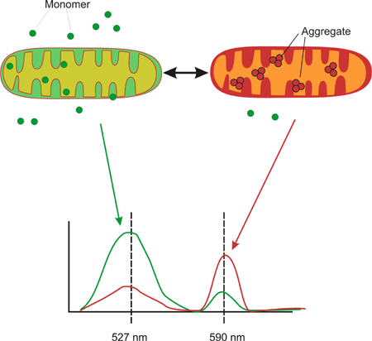
Mitochondrial Potential using JC-1
Easy discrimination between polarized (healthy) cells, depolarized (apoptotic) cells and necrotic/late apoptotic cells
Polarized
JC-1 is a lipophilic, cationic dye for detection of depolarization
    Early in apoptosis the electrochemical gradient over the mitochondrial membrane collapses
Depolarized
Polarized
Apoptotic
Healthy
Notes:
Very early in apoptosis the electrochemical gradient over the mitochondrial membrane collapses. This collaps can be measured by JC-1, a lipophilic cationic dye.
JC-1 can fluorescece either red or green. In healthy cells with high membrane potential JC-1 accumulates in the mitochondria. This leads to formation of red aggregates
In apoptotic cells with low membrane potential JC-1 localises to the cytosol in its green monomeric form.
Hence, healthy cells is dominantly red whereas apoptotic cells a dominantly green.
A very early event in apoptosis is collapse of the electrochemical gradient across the mitochondrial membrane followed by uncoupling of the respiratory chain. In order to distinguish healthy and apoptotic cells a simple assay based on this phenomenon is to stain the cells using cationic dyes such as 5,5',6,6'-tetrachloro-1,1',3,3'-tetraethylbenzimidazolcarbocyanine iodide (JC-1) or tetramethylrhodamine methyl ester perchlorate or other compounds which fluoresces differently in the two populations. E.g. is JC-1 in healthy, non-apoptotic cells found in the mitochondrial matrix where it forms red fluorescent aggregates. However, in the event of a fall in the mitochondrial membrane potential (e.g. in connection to apoptosis) the dye returns to its monomeric form which is associated with a large emission shift to green. For the analysis of changes in mitochondrial membrane potential and hence apoptosis, the cells are incubated with the chosen cationic dye (e.g. JC-1) and analyzed at relevant wave lengths using NC-3000. If e.g. using JC-1 the shift from red to green are quantitated in order to determine the apoptotic cell population. A cell impermeable DNA stain (like DAPI) can be included to stain necrotic cells.
Mitochondrial membrane potential, Δψm, is an important parameter of mitochondrial function used as an indicator of cell health. JC-1 is a lipophilic, cationic dye that can selectively enter into mitochondria and reversibly change color from green to red as the membrane potential increases. In healthy cells with high mitochondrial Δψm, JC-1 spontaneously forms complexes known as J-aggregates with intense red fluorescence. On the other hand, in apoptotic or unhealthy cells with low Δψm, JC-1 remains in the monomeric form, which shows only green fluorescence.

Slide 17
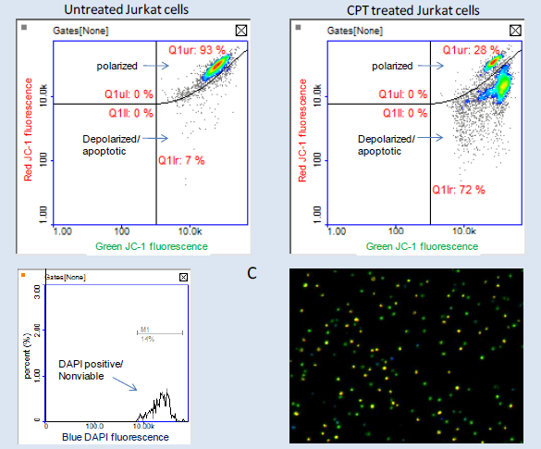
NC-3000™ Mitochondrial
Potential
Assay
CPT = Camptothecin (Topoisomerase inhibitor)
Notes:
Jurkat cells were grown in the absence (upper row) or in the presence (lower row) of camptothecin (CPT). Cells were stained with JC-1 and DAPI and analysed using the Mitochondrial Potential Assay and a NucleoCounter® NC-3000™.
Scatter plots and histograms were obtained from the NucleoView® NC-3000™ software. Polygons and markers in the displayed plots were used to demarcate the various cell populations. In this example untreated cells are 9% depolarized/apoptotic whereas CPT-treated cells are 61% depolarized/apoptotic.

Slide 18
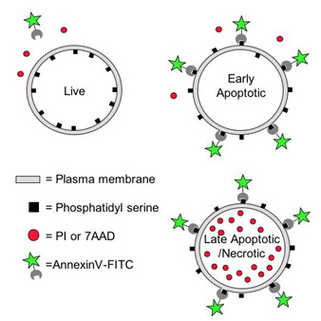
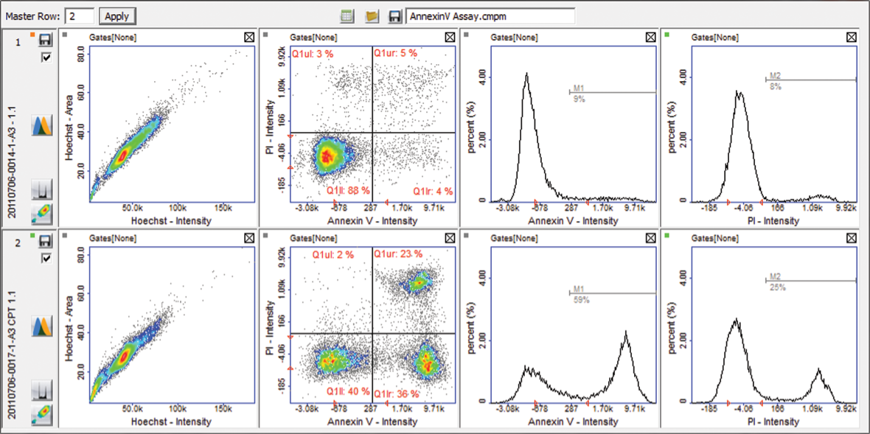
Annexin V
Information about both early apoptotic and late apoptotic/necrotic cells provided
N
V
A
Untreated Jurkat cells
CPT-treated Jurkat cells
V = viable cells
A = apoptotic cells
N = necrotic (late apoptotic) cells
CPT = Camptothecin (topoisomerase inhibitor)
Notes:
Using fluorescence microscopy and image analysis the NucleoCounter® NC-3000™ system automates detection of apoptotic cells based on phosphatidylserine externalization. Cells are stained with Hoechst 33342, PI and FITC labeled Annexin V.
Hoechst 33342 stains the total cell population, while Annexin V stains apoptotic and necrotic cells. Early apoptotic cells exclude PI, while late stage apoptotic and necrotic cells stain positively for both Annexin V and PI.

Slide 19
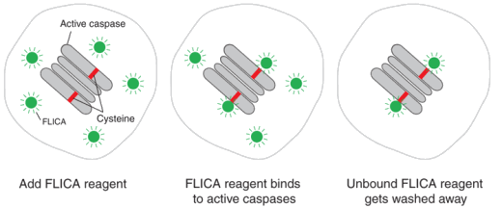
Caspase 3/7, 8 & 9
Information about both early apoptotic and late apoptotic/ necrotic cells provided
Caspases (cysteine-dependent aspartate-directed proteases) are a family of protease enzymes playing essential roles in programmed cell death and inflammation.
Notes:
Using fluorescence microscopy and image analysis, the NucleoCounter® NC-3000™ system automates detection of apoptotic cells based on caspase activity. Cells are stained with Hoechst 33342, PI and carboxyfluorescein labeled FLICA reagent.
The total cell population is stained with Hoechst 33342, while early apoptotic and late apoptotic/necrotic cells are stained with carboxyfluorescein labeled FLICA reagent and PI, respectively.

Slide 20
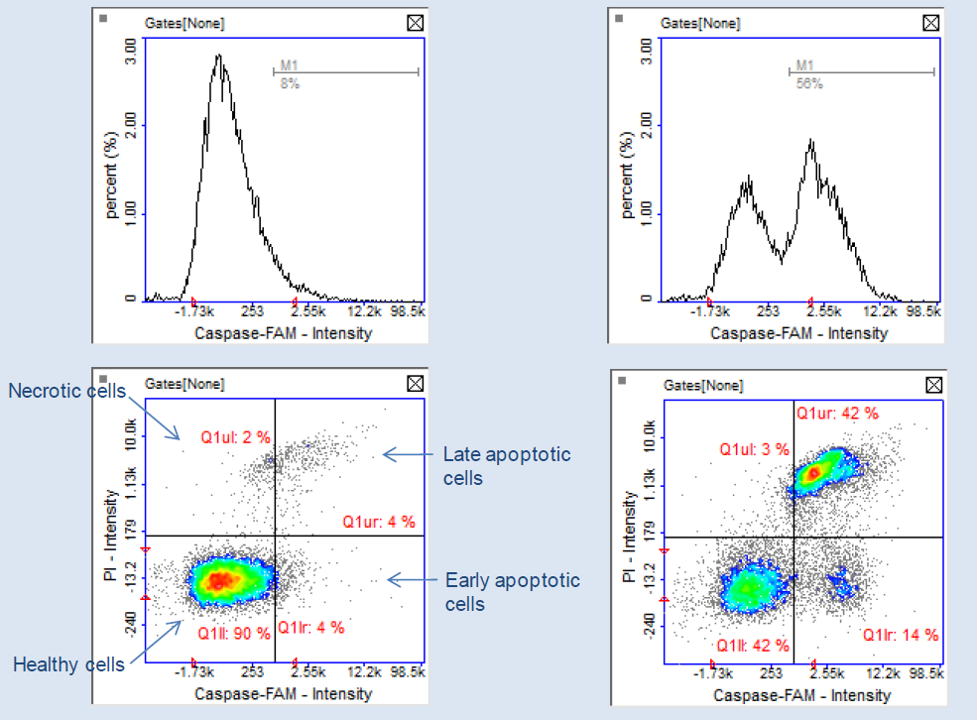
NC-3000™ Caspase Assay
CPT = Camptothecin (Topoisomerase inhibitor)
Notes:
Jurkat cells were grown in the absence (upper row) or in the presence (lower row) of camptothecin (CPT). Cells were stained with Hoechst-33342, FLICA reagent (FAM) and Propidium Iodide (PI) and analysed using the Caspase Assay and a NucleoCounter® NC-3000™.
Scatter plots and histograms were obtained from the NucleoView® NC-3000™ software. Polygons and markers in the displayed plots were used to demarcate the various cell populations. In this example camptothecin causes a dramatic increase of early apoptoctic cells (Caspase FAM positive and PI negative cells).

Slide 21
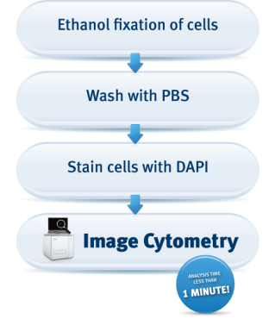
DNA Fragmentation
Easy measurement of DNA fragmentation at the single cell level
DNA fragmentation is a one of the hallmarks of late apoptotic cells
Acquisition and analysis in one simple step
User friendly protocol with predefined settings
Standardized results – even with different users
No RNase treatment required
No calibration required
Notes:
Using fluorescence microscopy and image analysis, the NucleoCounter® NC-3000™ system automates detection of cells with fragmented DNA (sub-G1 cells).
After DAPI staining of fixed cells the sample is analyzed using the NucleoCounter® NC-3000™ system and cellular fluorescence is quantified and apoptotic cells with fragmented
DNA are seen as a sub-G1 peak in a DNA content histogram displayed on PC screen. Markers in the histogram can be used to demarcate apoptotic cells.

Slide 22
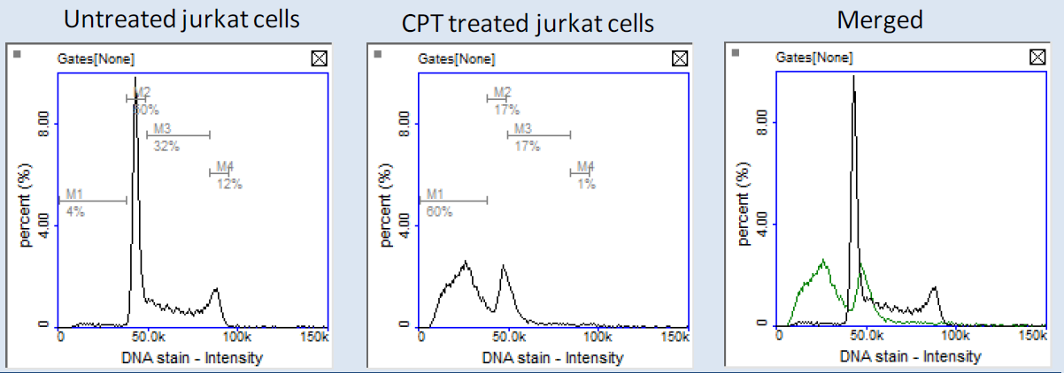
NC-3000™ DNA Fragmentation Assay
CPT: Camptothecin (Topoisomerase inhibitor)
Notes:
Jurkat cells were grown in the absence (upper row) or in the presence (lower row) of camptothecin and cells were analysed using the DNA Fragmentation Assay and a NucleoCounter® NC-3000™. Scatter plots and histograms were obtained from the NucleoView® NC-3000™ software.
Markers in the displayed histograms were used to demarcate cells with fragmented DNA (Sub-G1 cells). Colored histogram is a merge between untreated (blue line) and camptothecin treated (red line) samples.

Slide 23
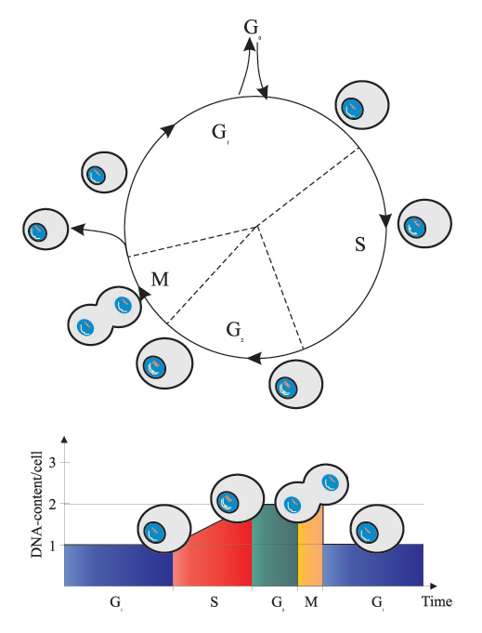
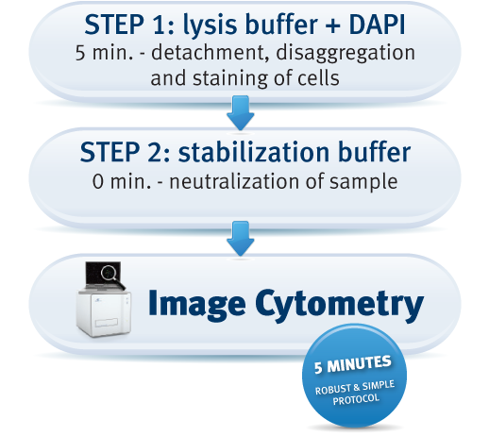
Two-step Cell Cycle Assay
Fast and easy measurement of cell cycle phases at the single cell level
No ethanol fixing
Directly from culture (no detachment step)
No RNase treatment required

Slide 24
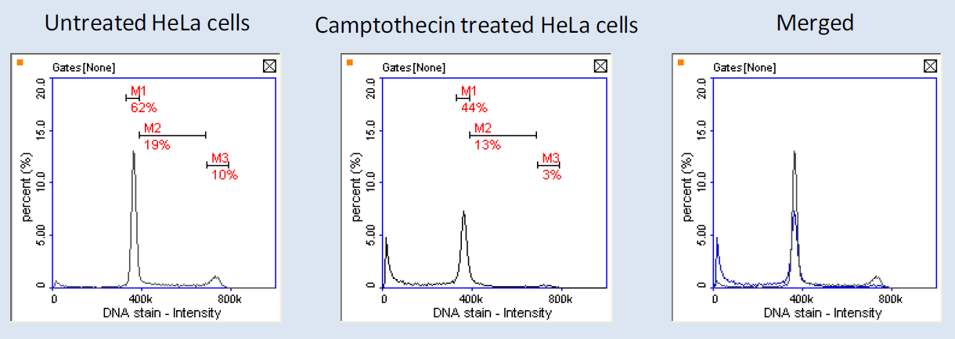
NC-3000™ Two-step Cell Cycle Assay
CPT: Camptothecin (Topoisomerase inhibitor)

Slide 25
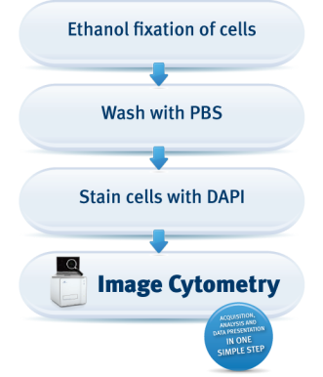
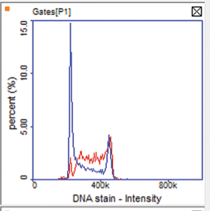
Cell Cycle of Fixed Cells Assay
Easy measurement of cell cycle phases at the single cell level
--- ETO-treated
--- Untreated
ETO: etoposide (topoisomerase inhibitor)
Notes:
Using fluorescence microscopy and image analysis, the NC-3000 system automates DNA content quantification and hence, measurements of cell cycle stages. The NC-3000 Cell Cycle Assay uses the nuclear stain, DAPI, to measure DNA content. DAPI binds specifically to double-stranded DNA and, accordingly, there is no requirement for removing RNA prior to DNA content measurements.
This is a prerequisite for other dyes commonly used for measurements of cell cycle phases, such as propidium iodide. After DAPI staining of fixed cells the sample is analyzed using the NC-3000 system and cellular fluorescence is quantified and DNA content histograms are displayed on PC screen. Markers in the displayed histograms can be used to demarcate cells in the different cells cycle stages.
The Cell Cycle of Fixed Cells Assay possesses the possiblity of storing cells for several weeks. Thus, after ethanol fixation the cells can be left in the fridge for a longer period before analysing the sample.

Slide 26
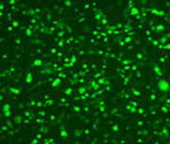
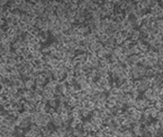
GFP Transfection Efficiency
Transfection
  Transfection/transformation = introduction of foreign DNA into an eukaryote cell
  Fluorescent proteins are often used as markers of transfection
  Tool for studying gene regulation and expression
  Determination of transfection efficiency often required in functional studies
Fluorescence
Phase contrast
Transfection efficiency???
Notes:
Very briefly: transfection (with fluorescent proteins) – just the required to understand the concept ”transfection efficiency analysis”

Slide 27
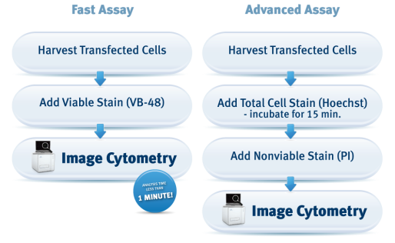
GFP Transfection Efficiency
Fast and easy-to-use assay for measuring transfection efficiency
Transfected cells
+
All cells
C_{FP} concentration of cells expressing fluorescent protein
C_{t} total concentration of cells
Notes:
In order to determine the transfection ratio, a suspension of cells transfected with GFP is stained with either VB-48 (the fast method) or Hoechst and PI (the advanced method). After staining cells are loaded into either of two types of ChemoMetec slides: the 2-chamber NC-Slide A2™ or the 8-chamber NC-Slide A8™.
Samples are analyzed using the NucleoCounter® NC-3000™ system.
For both methods the transfection ratio and a histogram showing the GFP intensity is shown, moreover, for the advanced method the transfection ratio of nonviable cells is also determined.

Slide 28
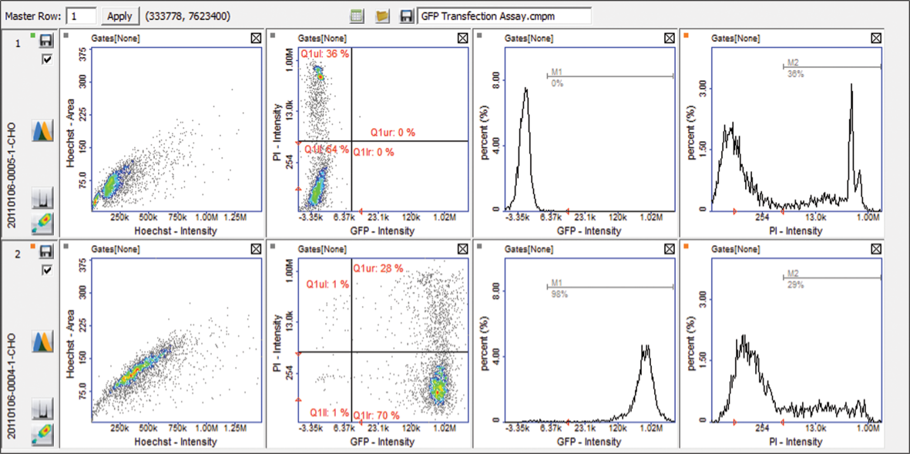
NC-3000™ GFP Transfection Efficiency
Notes:
CHO cells were transfected with, respectively, a GFP harbouring plasmid (lower row) and a plasmid without GFP (upper row). 24 hours after transfection cells were stained with Hoechst-33342 and Propidium Iodide (PI) and analysed using the GFP Transfection Assay – Hoechst PI and a NucleoCounter® NC-3000™.
Scatter plots and histograms were obtained from the NucleoView® NC-3000™ software. Polygons and markers in the displayed plots were used to demarcate the various cell populations.

Slide 29
NucleoCounter® NC-3000™
7 colors, 9 filters from UV to far red
Create user adaptable protocols with FlexiCyte™
Easy to perform range of fixed protocols
High speed cell count
Easy to operate – no training, calibration or service
No flow, no rinsing, no clogging
Superior data visualization with the PlotManager
Export data to FCS Express 4 Image Cytometry etc.
Get Visual inspection of your cells
Low costs per sample
Learn more at www.chemometec.com/nc-3000

