Slide 1


Slide 2
Agenda
Introduction & New Product Highlights
Synergy Review
  Product Line
  Competitive Review
  Applications Focus
Applications & Demo Scenarios
Imaging Introduction
Cytation3 Hardware & Technical Review
Cytation3 Application Workflow
Cytation3 Demo / Hands-on

Slide 3
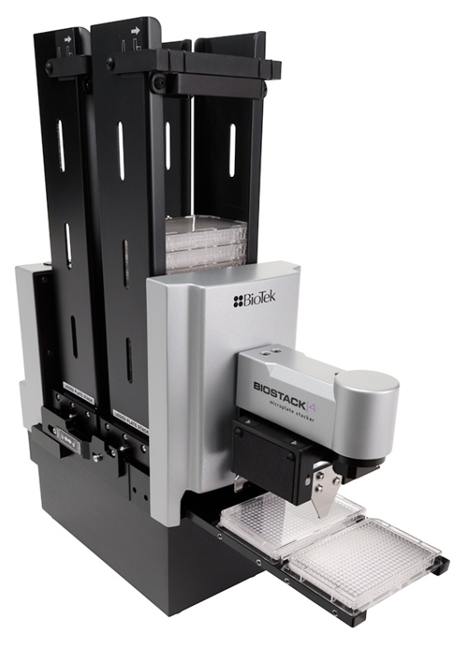
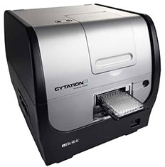
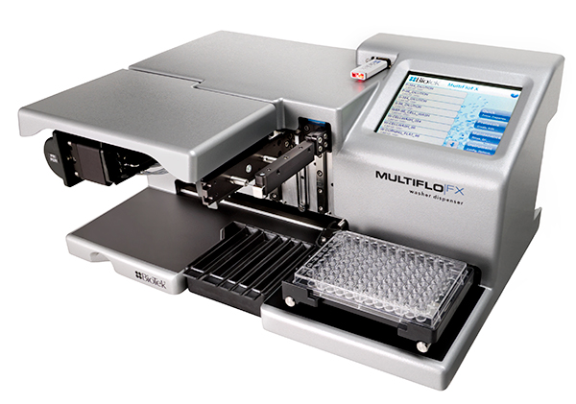
Lets get started…
2013 New Products and a glimpse into 2014

Slide 4
Contents
Context
Challenges
Opportunities
Cytation3
Review
New: 40x and 60x on Cytation3
New: MultiFlo FX
New: BioStack4

Slide 5
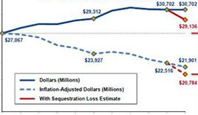
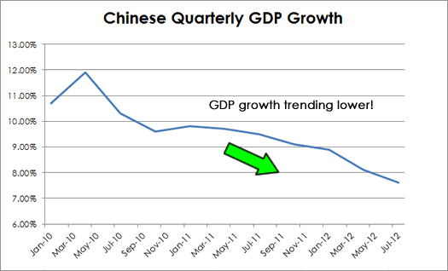
Challenges: Government Funding
US sequestration
Europe debt crisis and economic slow down
Even China is slowing down

Slide 6
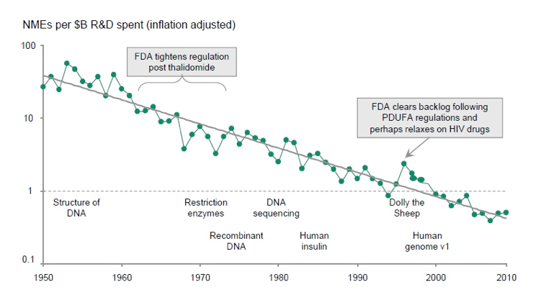
Challenges: Industrial Funding
R&D site closures (US and Europe)
Relocation of R&D sites (China)
Outsourcing to CRO and Academia
Source: Bernstein Research “The Long View – R&D Productivity” September 30, 2010

Slide 7
Challenges
Limited government and private funding: lower demand
Lower demand is pushing prices down
Most sales opportunities are very competitive
Bottom line is: less opportunities, more competition
What can we do?

Slide 8
Contents
Context
Challenges
Opportunities
Cytation3
Review
New: 40x and 60x on Cytation3
New: MultiFlo FX
New: BioStack4

Slide 9
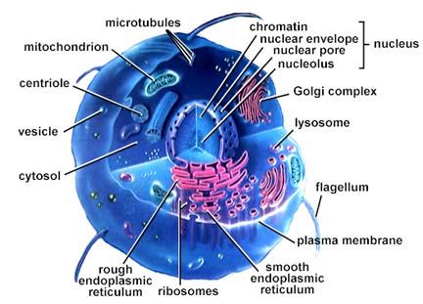
Cellular Research: Well Funded
Cancer biology (National Cancer Institute ~ 20% NIH Budget)
Neurodegenerative diseases
Stem cells, iPS
Tissue Engineering , Cell therapy
Cell-based drug screening assays

Slide 10
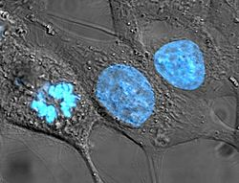
Biological tools - HeLa
It is the oldest and most commonly used human cell line
The line was derived from cervical cancer cells taken in 1951 from Henrietta Lacks
This cell line is immortal. Normal cells stop dividing in-vitro after about 50 division cycles.
10% to 20% of all cell cultures are thought to be contaminated with HeLa cells
In vitro human model (vs. animal)

Slide 11
Biological tools – Other immortalized cell lines
Cell lines used in BioTek Cytation3 application notes:
Immortalized transformed keratinocytes – human skin cells
HT-1080 fibrosarcoma cells – human connective tissue
NIH3T3-GFP, fibroblast model – mouse connective tissue
HEK293 embryonic human kidney cells
U-2 OS osteosarcoma cells – human bone cancer model
SKOV-3 cells - human ovarian cancer model
ATCC (American Type Culture Collection) is a private, nonprofit biological resource center with large cell-line library

Slide 12
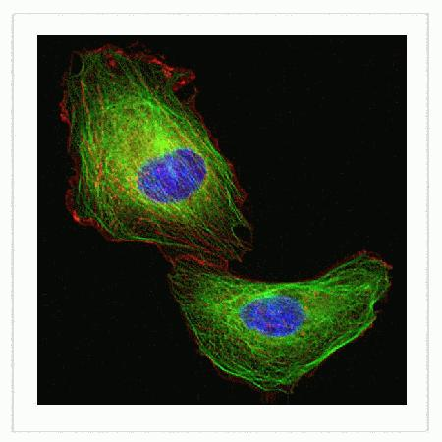
Powerful biochemical tools
Fluorescent stains: DAPI, Hoechst, ...
Fluorescent antibodies: 1° and 2° Abs with emission spanning Vis to near-IR
GFP and all its multicolor variants enable live cell analysis
Nucleus, Hoechst 33342
Microtubules, GFP
Actin filaments, RFP
… any protein can be localized and quantified in the cell

Slide 13
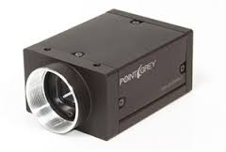
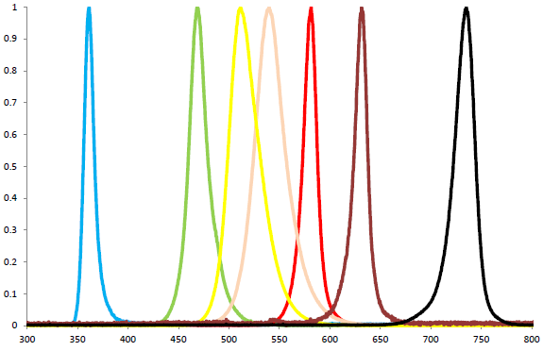
New cost effective hardware tools
CCD and CMOS cameras
  Compact
  Decreasing cost
  Improved performance at room temperature
LED light sources
  Powerful excitation
  Inexpensive
  Long life

Slide 14
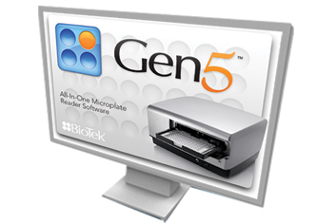
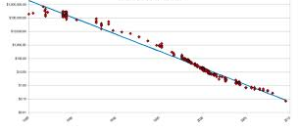
Computing power and storage capacity
Modern computers allow Gen5 to acquire and analyze images on the fly
Gen5 can have up to 50,000 images in memory at the same time
Cost of 1 GB in 2000: $10. Cost of 1 GB in 2010: $0.10. 1TB hard drive = $100.

Slide 15
A Combination of Opportunities
FUNDING
Cellular Biology Research is Well Funded
BIOLOGICAL TOOLS
Many in vitro human models available though immortalized cell lines
HARDWARE TOOLS
Cost effective imaging light sources and detectors
OPPORTUNITY
COMPUTING TOOLS
Ultra fast computers with TB memory at low cost
BIOCHEMICAL TOOL
Range of chemical, immuno-based and molecular biology tools for staining any protein
MICROPLATE SAMPLE FORMAT
Ideally suited to run large scale research on complex biological systems

Slide 16
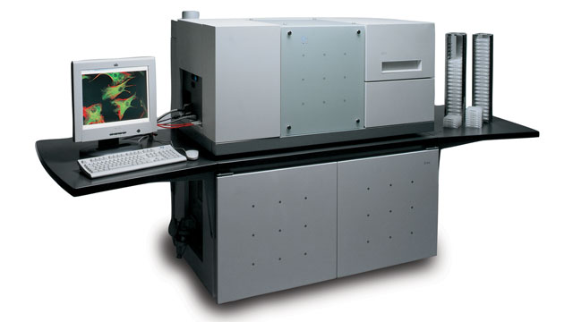
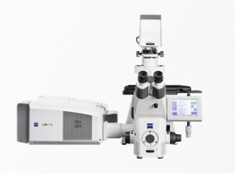
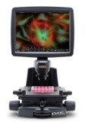
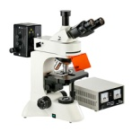
Imaging market ready for something new…
HCS
(Widefield or Confocal)
1000
Phenotypic screening
Price (kUS$)
Confocal
100
“z” stacking
Laser-based sensitivity
Digital
Widefield
Ease of use
Image portability
10
Widefield
Inexpensive
Performance

Slide 17
… and tools are needed to automate cellular assays
Not only imaging but also…
Liquid handling, sample preparation
Sample handling, microplate automation
BioTek is launching a full range of products geared towards cellular assays

Slide 18
Contents
Context
Challenges
Opportunities
Cytation3
Review
New: 40x and 60x on Cytation3
New: MultiFlo FX
New: BioStack4

Slide 19
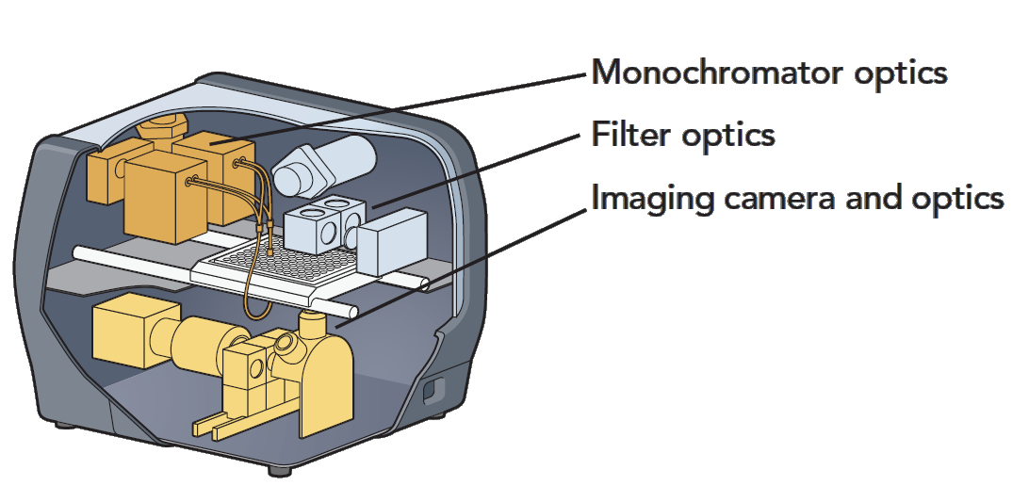
Cytation3 Optics

Slide 20
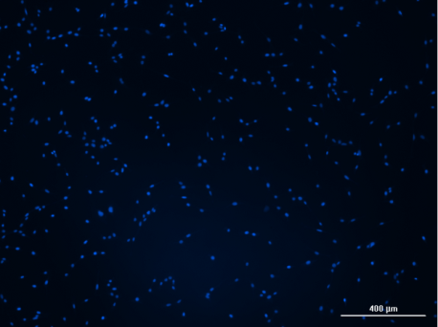
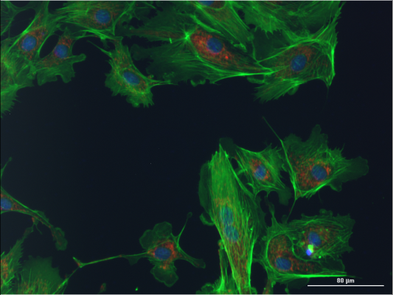
Low and High Magnification, Multi-Color Images

Slide 21
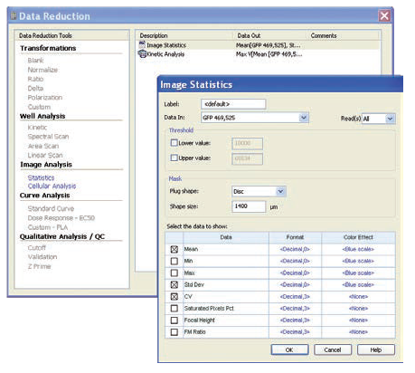
Image Statistics

Slide 22
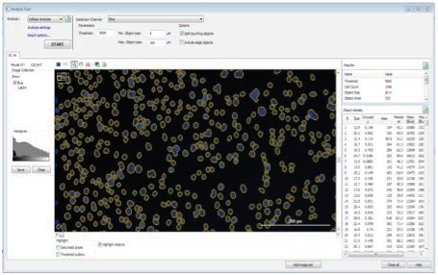
Cell Counting and Cellular Analysis

Slide 23
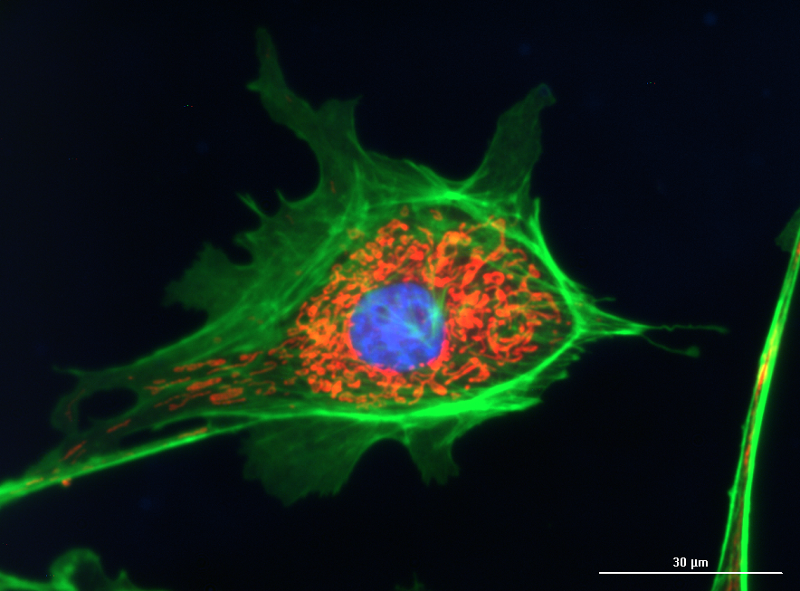
Cytation3 - New 40x and 60x Objectives
Shipping in January 2014
Official biotek.com launch: early November
Will require new instrument hardware (new Z focus mechanism)

Slide 24
Contents
Context
Challenges
Opportunities
Cytation3
Review
New: 40x and 60x on Cytation3
New: MultiFlo FX
New: BioStack4

Slide 25
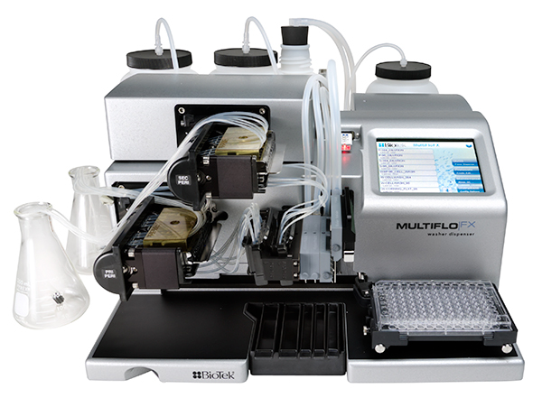
Introduction: New MultiFlo™ FX Microplate Dispenser

Slide 26
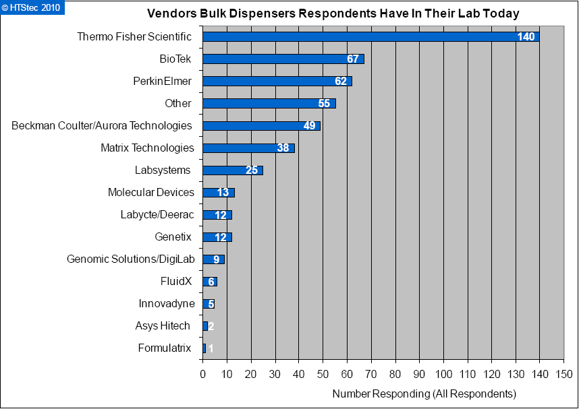
Introduction: BioTek’s position in Dispenser Market
BioTek reagent dispensers have developed brand recognition since 2002 MicroFill™ release
Brand strengthened with 2008 MicroFlo™ Select and 2010 MultiFlo ™ release
BioTek has successfully taken market share away from market leaders (i.e. Thermo Multidrop),

Slide 27
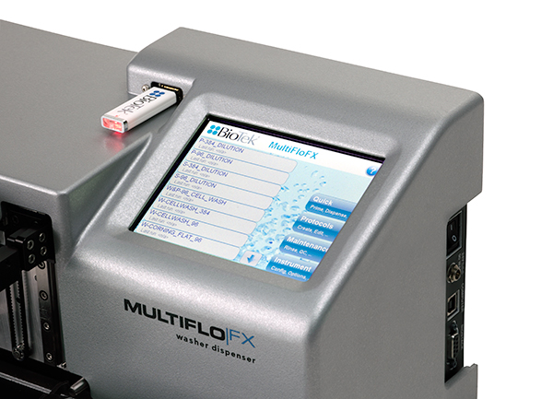
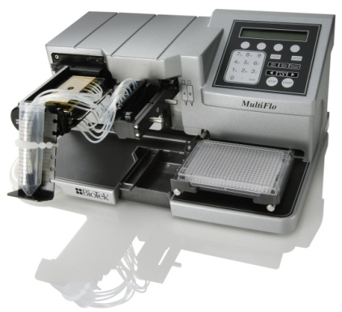
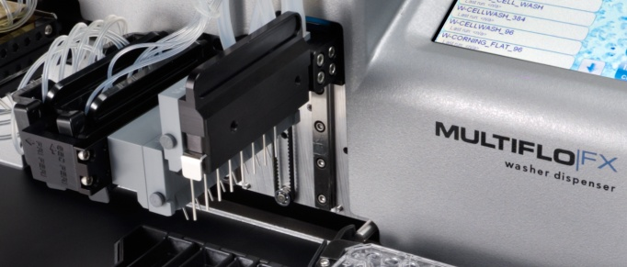
Overview: MultiFlo FX Key Attributes
+
5.7” Touch Screen Interface
+
Retains MultiFlo Functionality
Strip-based Wash Module

Slide 28
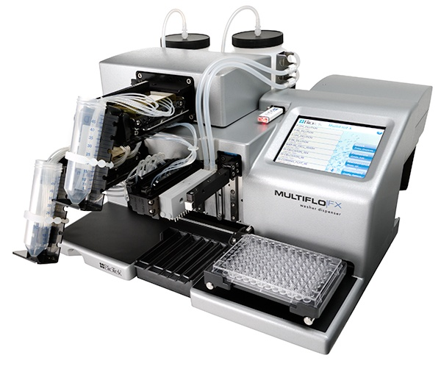
Overview: Dispensing
From 500 nL to 3,000 μL
6- to 1536-well microplates
Up to four independent reagents
Parallel Dispense™ Technology
  Peri-pumps: fast, low volume range, easy back-flushing
  Syringe-pumps: workhorses, no recalibration, no cassette cost
7º angled dispensing for minimized disturbance to loosely adherent cells
Autoclavable dispense paths
Highly Flexible, Cell-Friendly Dispenser…

Slide 29
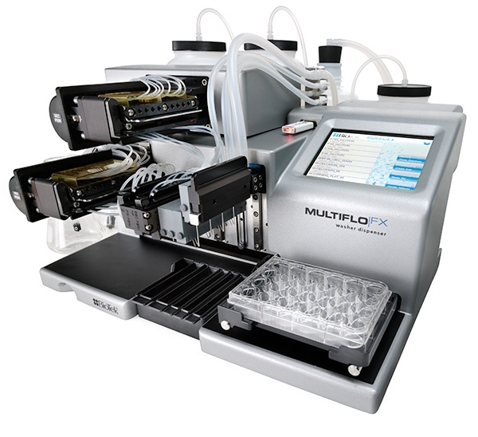
Overview: Washing
Washes 6- to 384-well microplates
From 20 uL to 30,000 μL
Patented Dual-Action™ manifold, same concept as 405 range
Optimized cell washing with low-flow rates and 20° angled dispense tubes
Highly Flexible, Cell-Friendly Washer…

Slide 30
Overview: Easy-to-Use Software
Same powerful on-board computer as 405TS
Best interface on the market: flexible, easy-to-use, powerful
USB port for protocol transfer and full compatibility with LHC

Slide 31
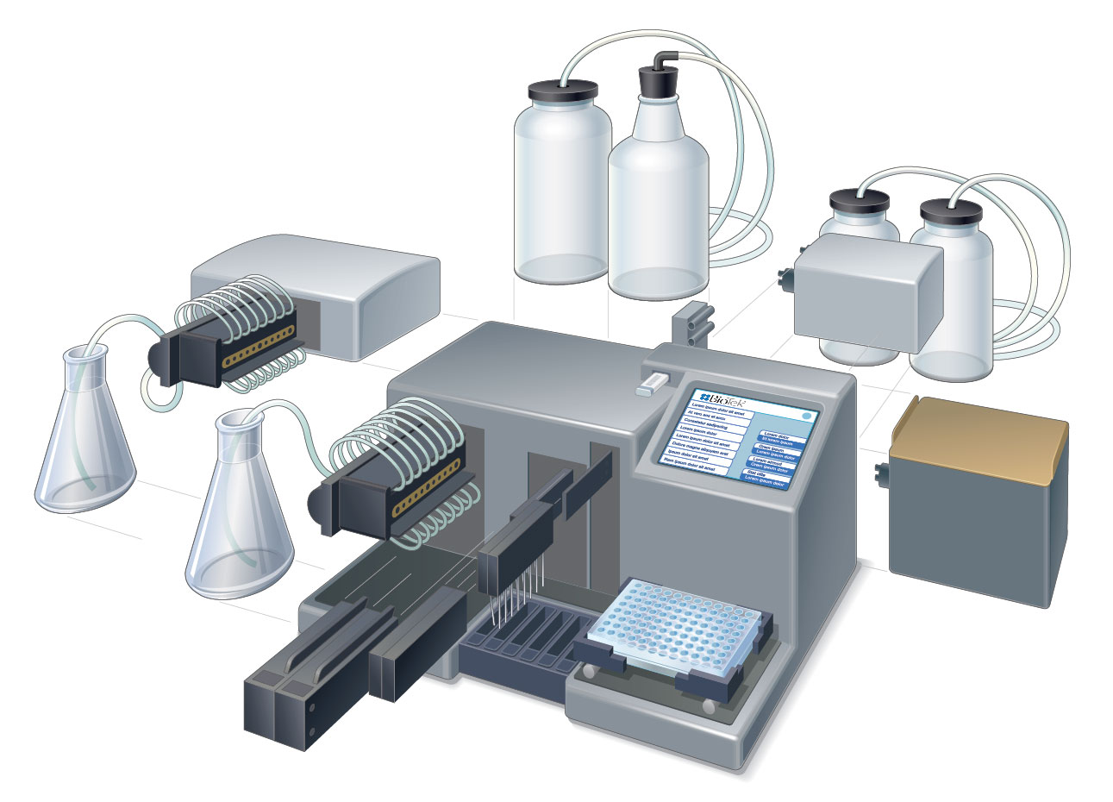
MultiFlo FX Microplate Dispenser: Unmatched Flexibility

Slide 32
Contents
Context
Challenges
Opportunities
Cytation3
Review
New: 40x and 60x on Cytation3
New: MultiFlo FX
New: BioStack4

Slide 33
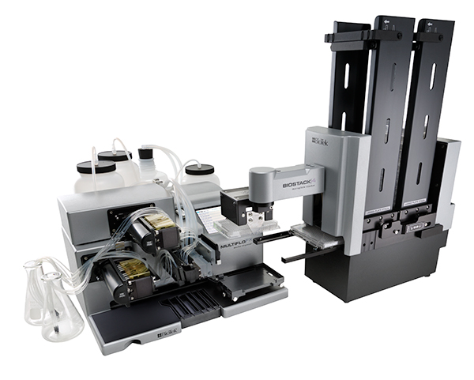
BioStack4

Slide 34

Overview: BioStack4
DE-LIDDING FUNCTIONALITY for 96-well plates and up
24-, 48-, 96-, 384- and 1536-well plates
Same dual carrier as BioStack3 for ultra fast plate processing
Ideal for automating cellular assays

Slide 35
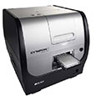
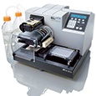
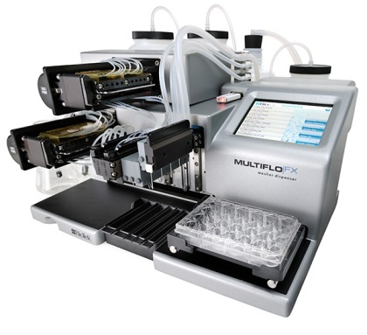
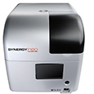
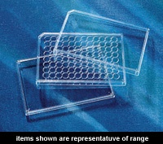
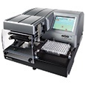
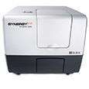
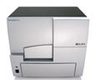
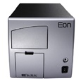
Overview: BioStack4

Slide 36
Summary: A Combination of Opportunities
FUNDING
Cellular Biology Research is Well Funded
BIOLOGICAL TOOLS
Many in vitro human models available though immortalized cell lines
HARDWARE TOOLS
Cost effective imaging light sources and detectors
OPPORTUNITY
COMPUTING TOOLS
Ultra fast computers with TB memory at low cost
BIOCHEMICAL TOOL
Range of chemical, immuno-based and molecular biology tools for staining any protein
MICROPLATE SAMPLE FORMAT
Ideally suited to run large scale research on complex biological systems

Slide 37
Summary: Tools for Today’s Life Science Research
3 unique new products from BioTek
Designed to support cell biology research
Targeted towards areas of growth
Cytation 3, MultiFlo FX and BioStack 4 have no direct competition
We anticipate great success for all with these new instruments

Slide 38
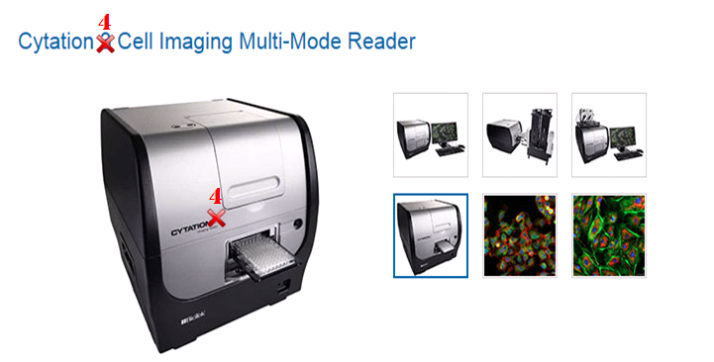
Coming in 2014…
A sustained cell biology focus…
  New 40x and 60x Objectives
  New & enhanced algorithms in Gen5
Plus more…

